Slide 1
A survey of deuterated molecules in regions of high mass star formation
Igor Zinchenko¹, Elena Trofimova¹,
Svetlana Sharabakina¹, Peter Zemlyanukha¹, Magnus Thomasson²
¹Institute of Applied Physics RAS,
²Onsala Space Observatory

Slide 2
Motivation
The effect of deuteration at low temperatures is rather well known. However its studies in warmer clouds are very limited.
Our goal is an investigation of this effect in a sample of high mass star forming regions on the basis of observations of the lowest rotational transitions of several deuterated molecules.

Slide 3
Observations
The observations were performed with the 20-m Onsala radio telescope in the following bands: (1) 71.94–74.44, (2) 75.45–77.95, (3) 83.94–86.44 and (4) 87.45–89.95 GHz.
The DCN, DNC, DCO⁺, N₂D⁺ (J=1-0) and ortho-NH₂D (J_{Ka,Kc} = 1_{1,1} - 1_{0,1}) lines were covered. The H¹³CN, HCN, HC¹⁸O⁺, HCO⁺, etc. lines were observed, too.
The sample includes objects with various indicators of high mass star formation.

Slide 4
Detection rates
DCO⁺ detected in 16 objects from 50
DCN detected in 17 objects from 50
DNC detected in 15 objects from 47
N₂D⁺ detected in 2 objects from 47
NH₂D detected in 15 objects from 50

Slide 5
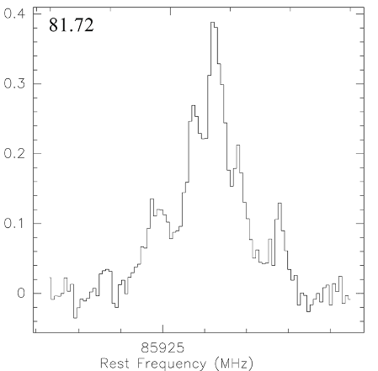
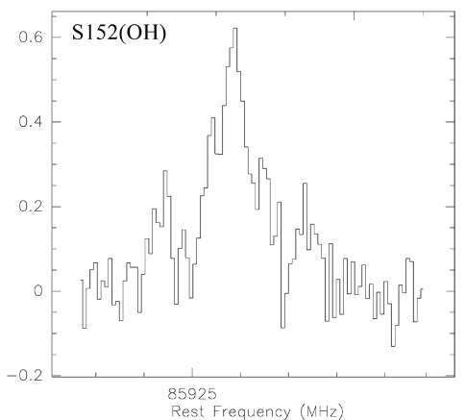
Hyperfine intensity anomalies in NH₂D

Slide 6
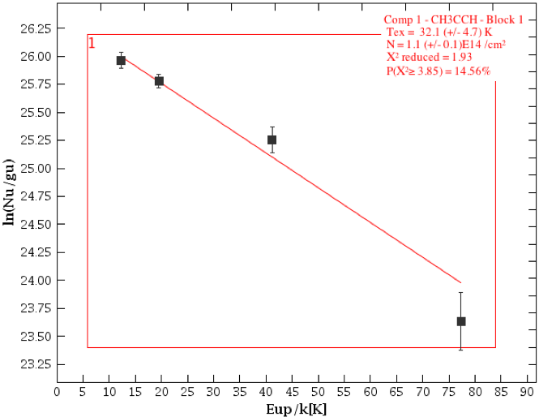
Temperatures
The gas temperatures have been either taken from the literature or, if possible, derived from the CH₃C₂H spectra by the method of rotational diagrams.

Slide 7
Relative abundances in dependence on temperature
DCO⁺
DCN
DNC

Slide 8
Deuteration fractions
DCO⁺
DCN

Slide 9
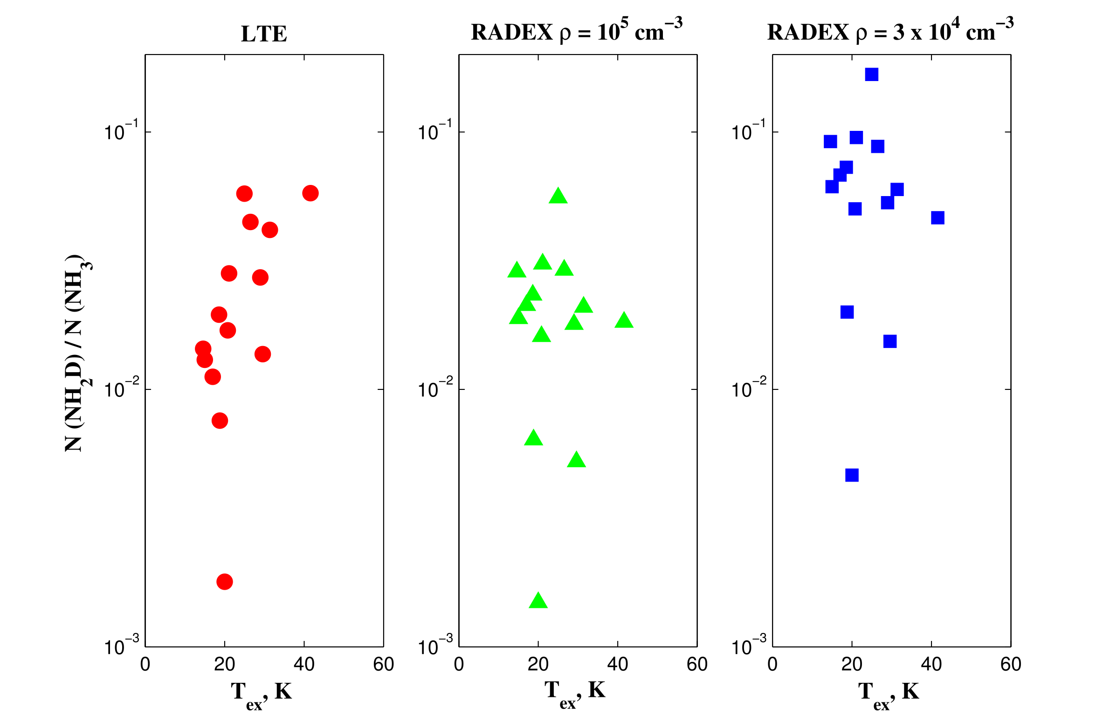
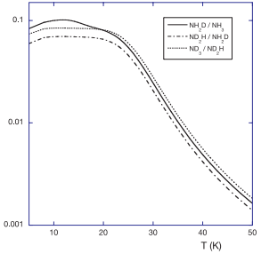
Deuteration in ammonia

Slide 10
Abundance ratios
DCO⁺/DCN
DCN/DNC

Slide 11
Dependences on the line width
DCO⁺
DCN

Slide 12
Correlation between the line width and temperature

Slide 13
Spatial distribution
Image – NH₂D,
contours – NH₃,
cross– IRAS source
diamonds – Н₂О masers.

Slide 14
Summary
DCO⁺, DCN, DNC and NH₂D are detected in about 1/3 of the observed sources, while N₂D⁺ only in 2 from 47 sources.
We detected hyperfine intensity anomalies in NH₂D.
The deuteration faction for DCO⁺ and DCN reach ~10⁻², for NH₂D it is even higher ~3x10⁻².
The DCO⁺ relative abundance drops with increasing temperature, while DCN abundance does not show a statistically significant dependence on temperature. The DCN/DNC ratio increases with temperature.

