Slide 1
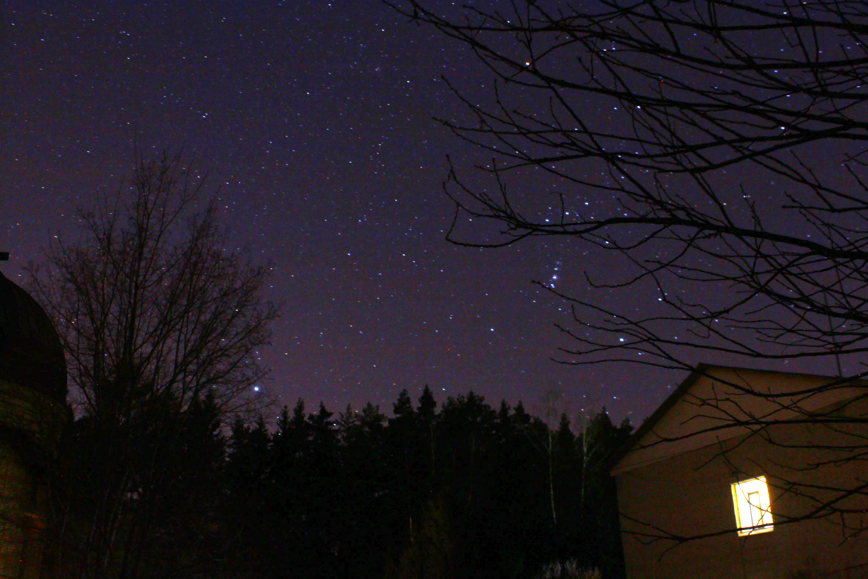
Simulations of merged H/H₂ and C⁺/C/CO transitions in the Orion Bar
Maria S. Kirsanova
Dmitri S. Wiebe
Institute of Astronomy of the
Russian Academy of Sciences
Moscow, Russia

Slide 2
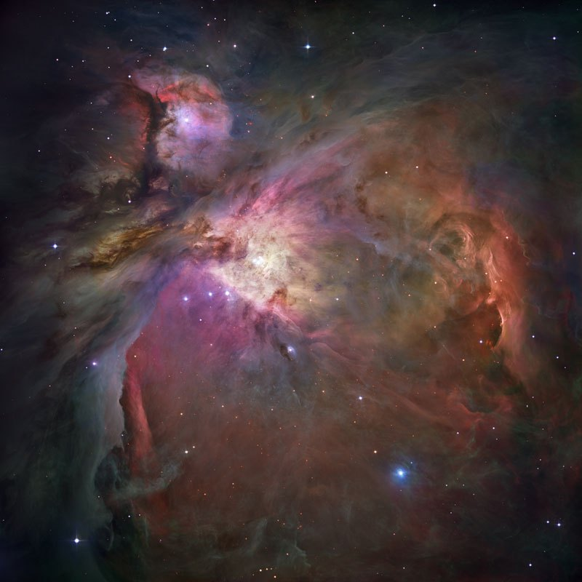
Orion Nebula
M43
M42
Trapezium: 560 stars in pc^{‒3} 4 massive stars θ¹ Ori C: Sp. type O7V 80% of ionizing photons
The nearest region of massive star formation at a distance of about 400 pc
Image from Robberto et al. (2013)

Slide 3
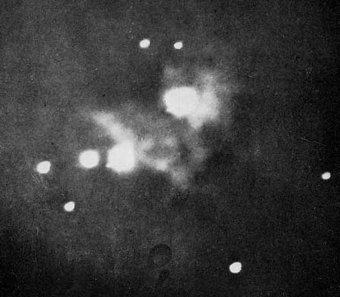
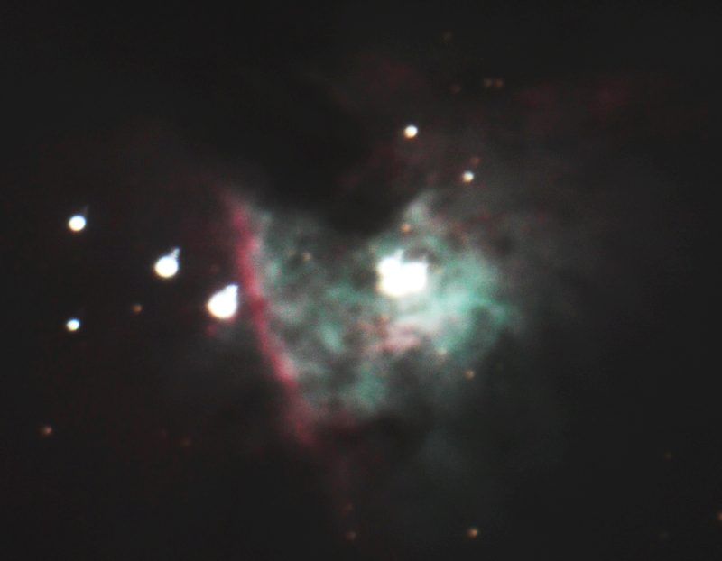
Orion Bar
Henry Draper (1880)
Trapezium, θ¹ Ori
Dark Bay
Orion Bar
θ² Ori
Dmitri Wiebe (2011)

Slide 4
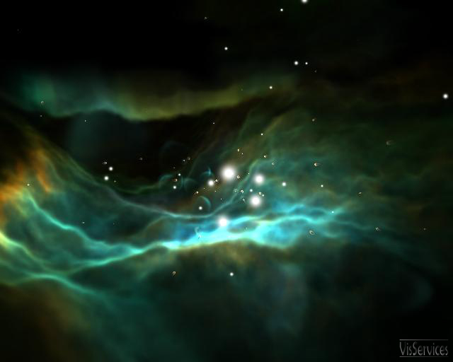
Photodissociation regions (PDRs)
PDR is a region where FUV (6-13.6 eV) photons dominate the energy balance and chemistry
Orion Bar PDR
Orion Veil
Vicinity of massive stars
Diffuse/translucent clouds
Envelopes of AGB stars
Planetary nebulae
Surfaces of protoplanetary disks
Main ionization front

Slide 5
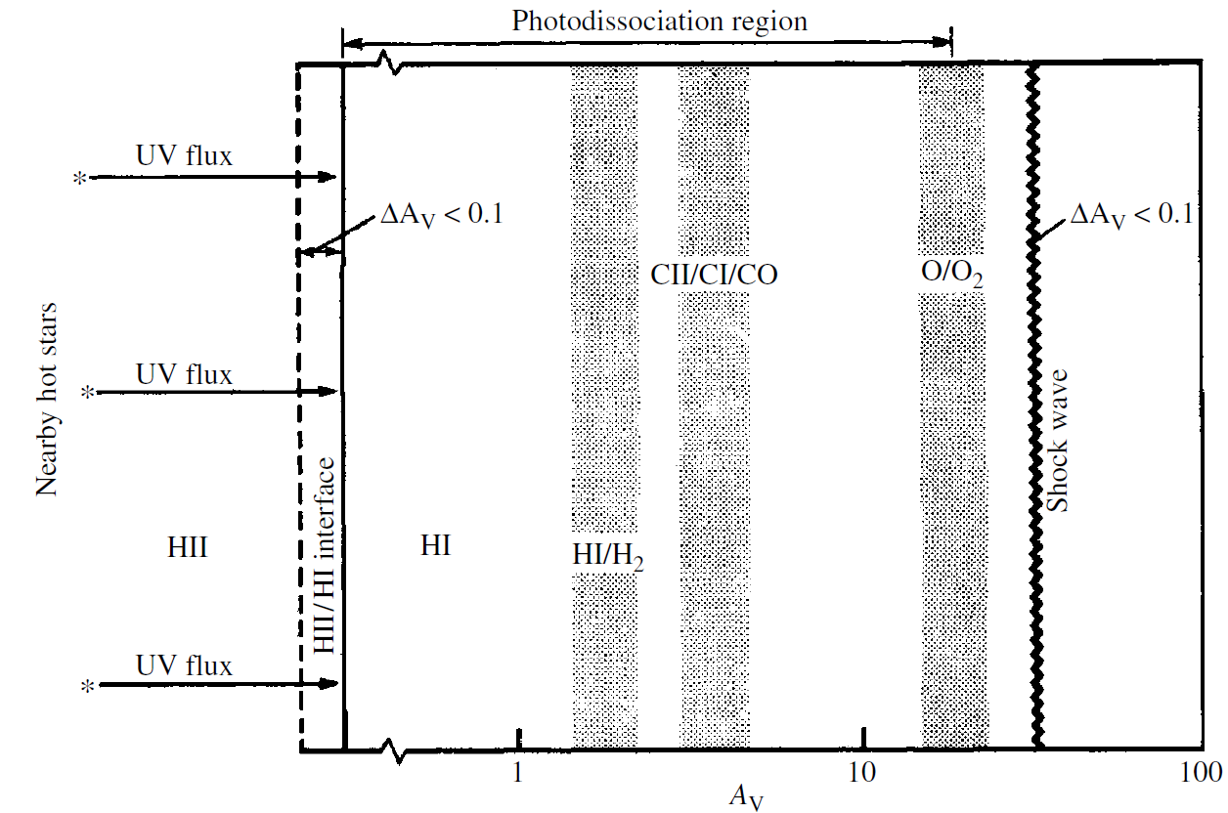
Classic representation of a dense photodissociation region
Tielens and Hollenbach (1985)

Slide 6
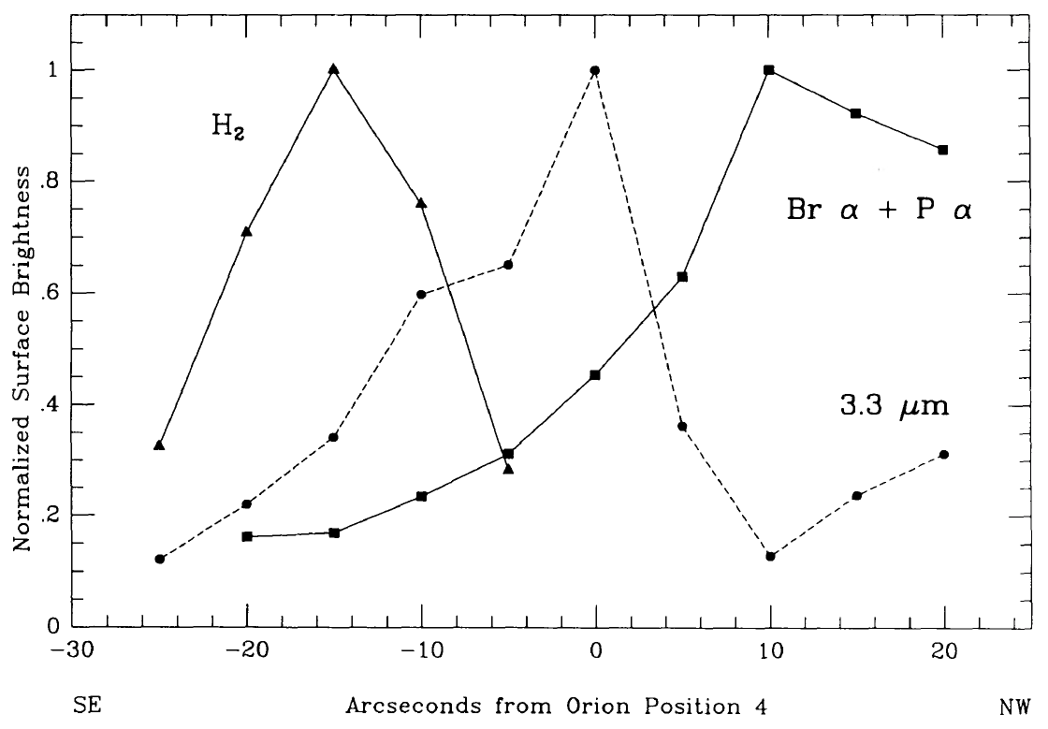
Spatial stratification of ionized gas, PAHs and molecular gas in the Orion Bar PDR
14″
10″
Sellgren et al. (1990)

Slide 7
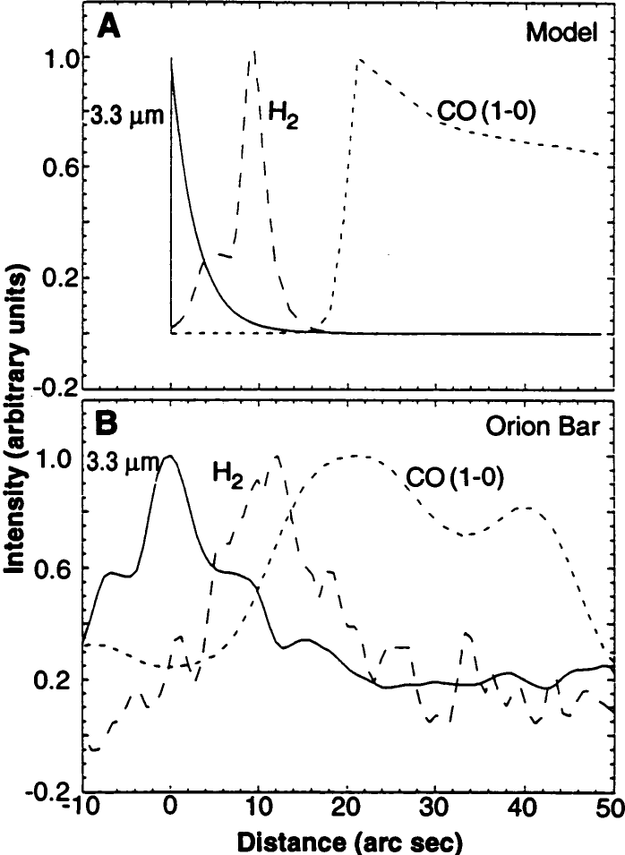
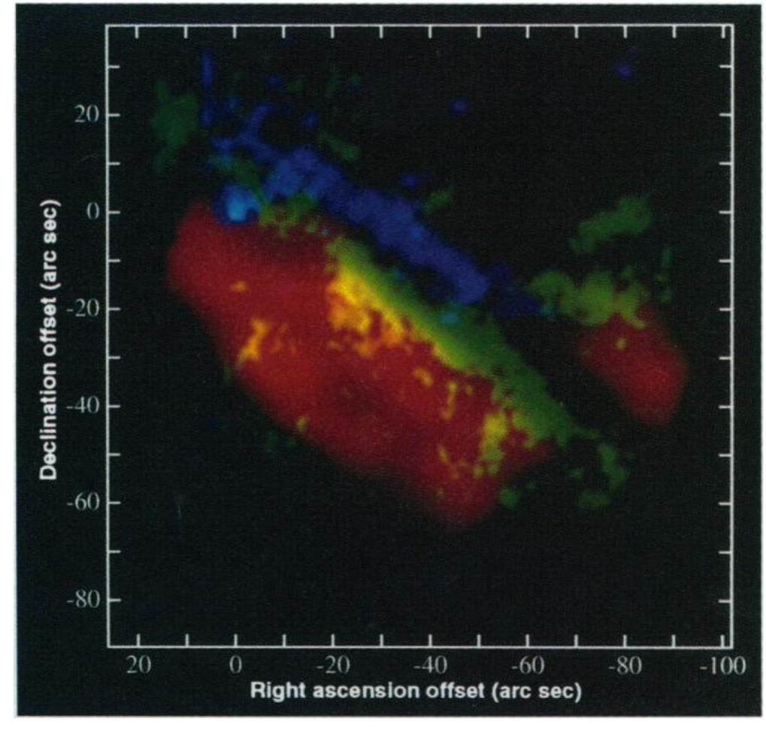
Success of the stationary PDR model
PAH 3.3 μm 1-0 S(1) H₂ CO(1-0)
Tielens et al. (1993)

Slide 8
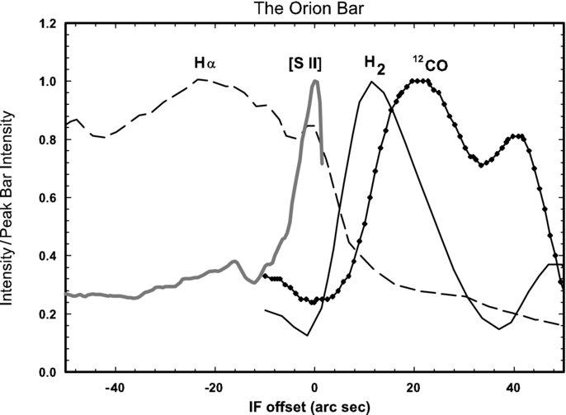
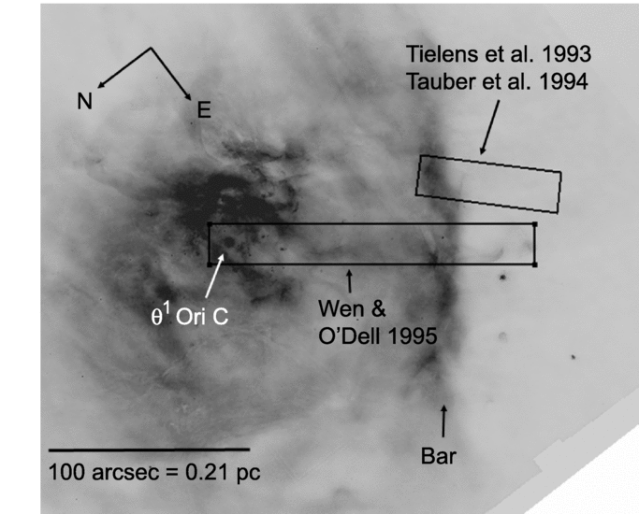
High magnetic field and CR are needed to reproduce the H⁺ – H₂ separation
– spatially resolved Hα, [SII], CO and H₂ observations – significant magnetic pressure and cosmic ray heating are needed to reproduce observational data in the pressure equilibrium model
Pellegrini et al. (2009)

Slide 9
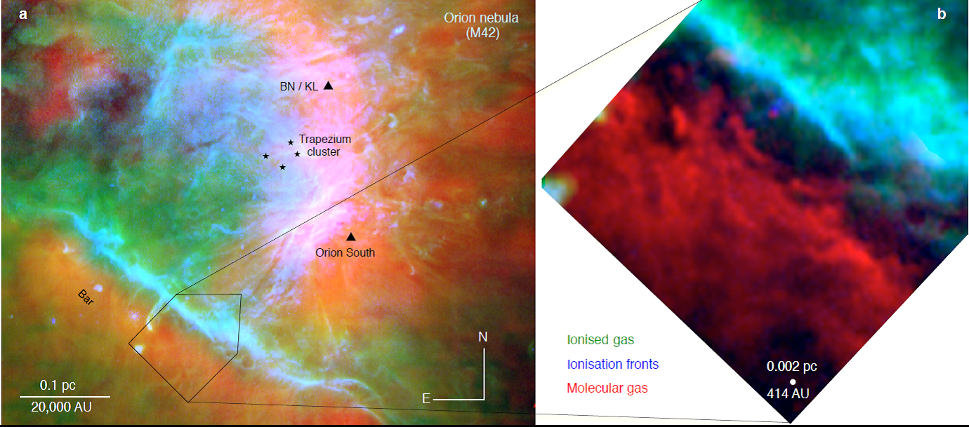
New ALMA observations of CO(3-2) and HCO⁺(4-3)
[SII] 6731 Å
Goicoechea et al. (2016)
[OI] 6300 Å
ALMA spatial resolution = 1″ for HCO⁺ (4-3)

Slide 10
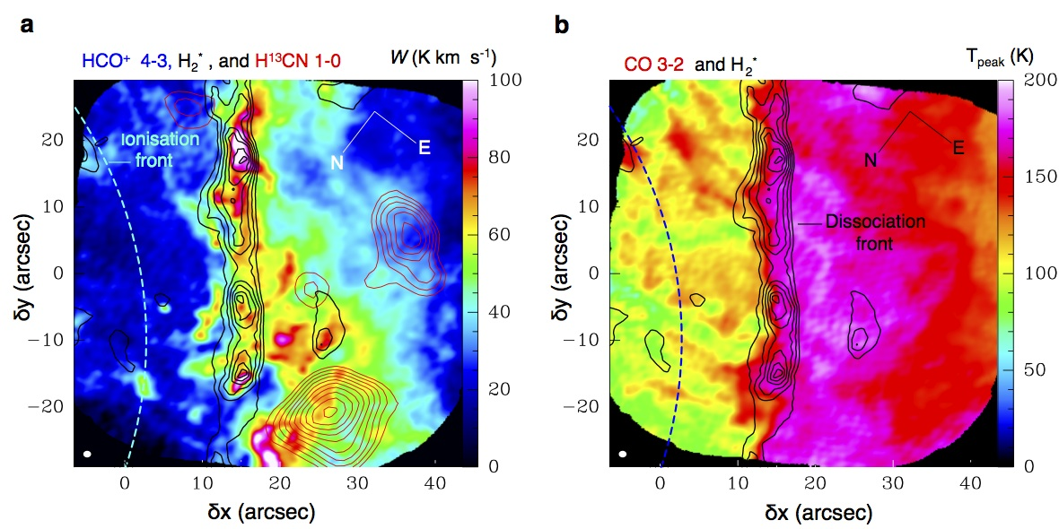
Merged H₂ and CO emission peaks
The H₂ и CO dissociation fronts are closer to each other (<1″) in comparison with the equilibrium model (10″)
Goicoechea et al., 2016

Slide 11
The aim of the present study:
Find a chemo-dynamical model, which predicts: – H₂/CO separation ≤ 1″ – T(CO 3-2) ≈ 160 K – W(HCO⁺ 4-3) ≈ 70 K km s‒1
Goicoechea et al., 2016

Slide 12
MARION model + RADEX
Kirsanova et al., 2009 Pavlyuchenkov et al., 2013 Akimkin et al., 2015, 2017
1D gas dynamics based on the ZEUS-2D code (Stone & Norman, 2002)
ionization, dissociation, gas phase chemistry + accretion and desorption
essential heating and cooling processes
dynamics of charged dust, dust size distribution
plane-parallel slab
no ionizing radiation
gas-phase chemistry
chemical network from the PDR benchmarking workshop (Rollig et al., 2007) + photo-reactions cross-sections from the Leiden photo site (van Dishoeck et al. 2006)
31 gas-phase species
χ at the surface = 40000
n_{gas} = 5·10⁴ cm-3
T_{gas} = 10K
dust model WD R_{V}=5.5
initial abundances from Cloudy «HII» set

Slide 13
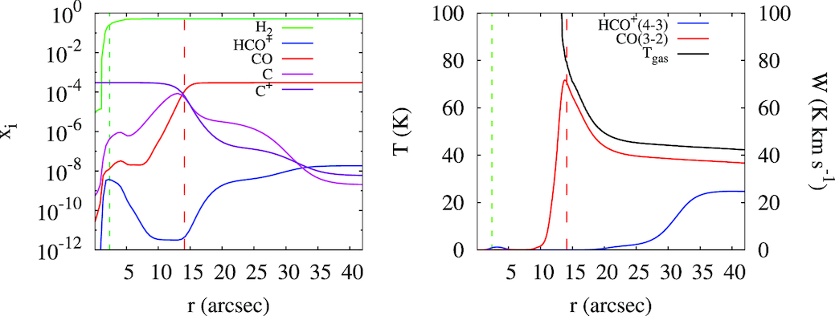
Stationary calculation for the Orion Bar PDR
Abundances
Line intensities
– H₂/CO separation ≈ 10″ – T(CO 3-2) « 160 K – no bright HCO⁺ 4-3 emission
CO dissociation front
H₂ dissociation front
r – distance from the origin of the computation domain
Kirsanova & Wiebe, 2019

Slide 14
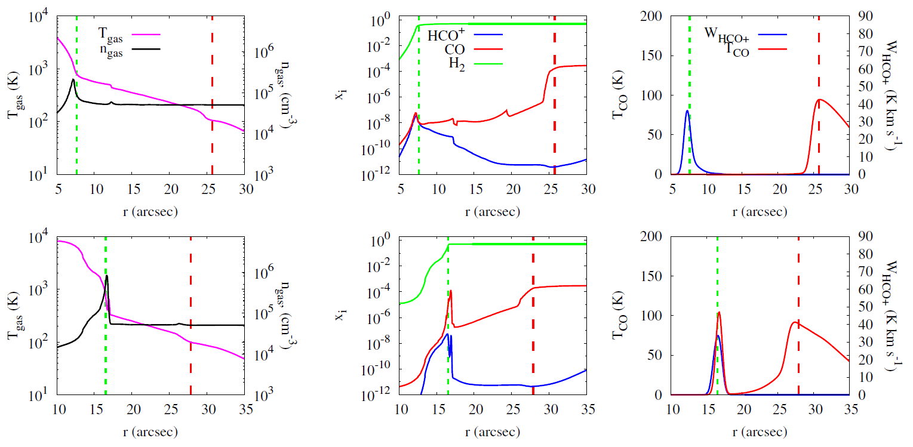

Slide 15
Time-dependent calculations
Gas parameters
Abundances
Line intensities
– H₂/CO separation ≈ 1″ – T(CO 3-2) ≈ 170 K – W(HCO⁺ 4-3) ≈ 50 K
H₂ dissociation front
Good agreement with the ALMA observations
CO dissociation front
Kirsanova & Wiebe, 2019

Slide 16
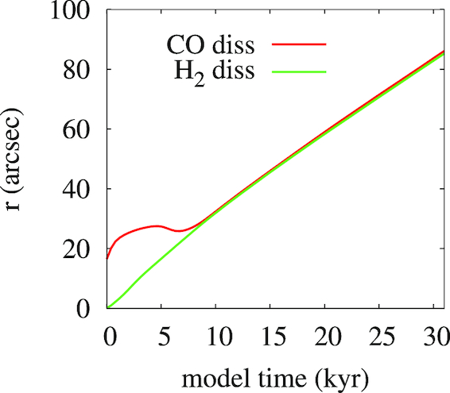
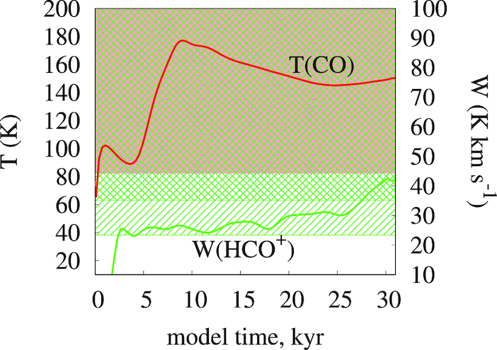
“Moving Stationary situation”
Location of the H₂ and CO dissociation fronts as a function of time
The emission intensities as a function of time
Kirsanova & Wiebe, 2019

Slide 17
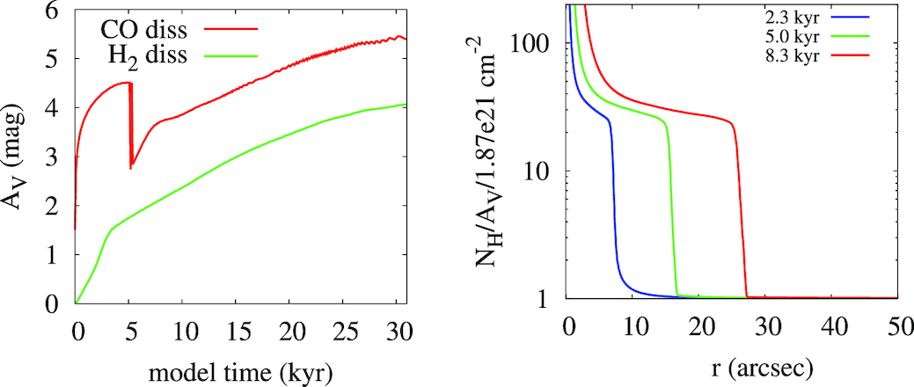
Gas-to-dust mass ratio and the H₂ and CO dissociation fronts
A_{V} = τ_{V} /1.086 τ_{V} depends on the current dust distribution
Location of the H₂ and CO dissociation fronts as a function of time
Kirsanova & Wiebe, 2019

Slide 18
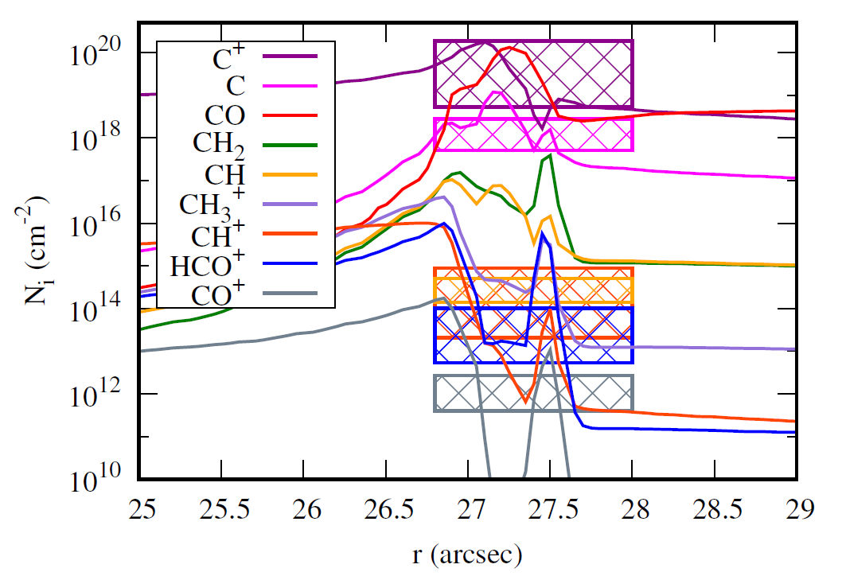
Column densities of the main carbon-bearing species
Kirsanova & Wiebe, 2019

Slide 19
Conclusions
Dynamical effects in the FUV-irradiated gas can be responsible for the observational appearance of the Orion Bar on the CO(3–2) and HCO⁺(4–3) maps produced by ALMA.
A_{V}, value grows on a short distance scale within the compressed layer, and the H₂ and CO dissociation fronts become close to each other, so that their angular separation is too small to be resolved even with the ALMA observations.
Dust expulsion from the PDR by the stellar radiation pressure speeds up the formation of the observed configuration.
Consequently, the locations of the H₂ and CO dissociation fronts, as well as the CO(3–2) and HCO⁺(4–3) emission peaks coincide on the ALMA maps

