Slide 1
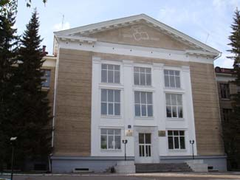
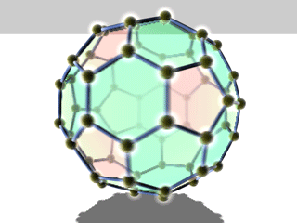
The Periodic Table Through Space and Time
10–13 September 2019
Saint Petersburg, Russia
ISOMERIC CARBON-CONTAINING COMPOUNDS OF INTERSTELLAR MEDIUM: STRUCTURE, ENERGY AND POLARIZABILITY
Denis Sabirov
diozno@mail.ru
Laboratory of Mathematical Chemistry
Institute of Petrochemistry and Catalysis
Russian Academy of Sciences
Ufa, Russia

Slide 2
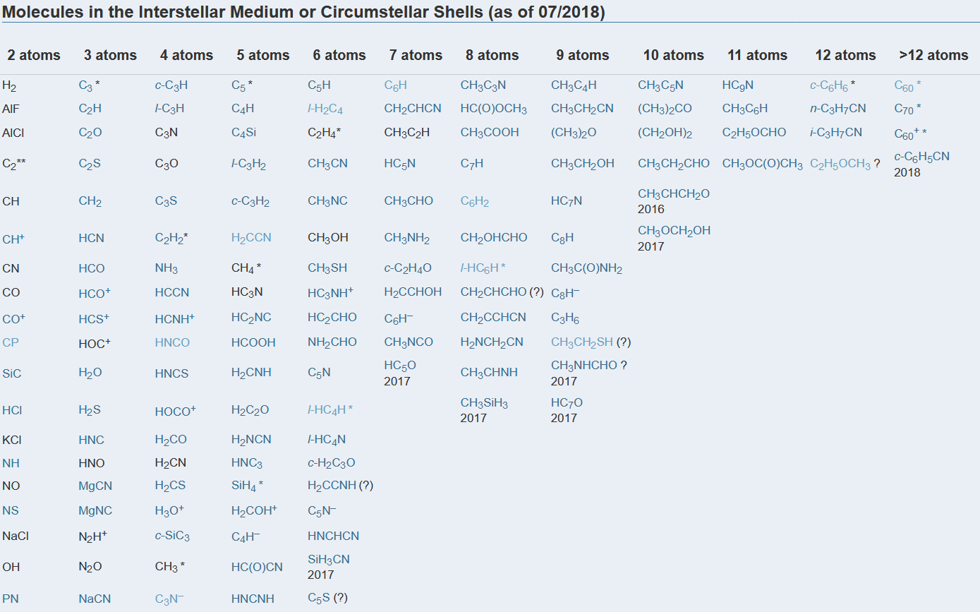

List of interstellar molecules (ISM + CSE)
The Cologne Database for Molecular Spectroscopy
www.astro.uni-koeln.de/cdms

Slide 3
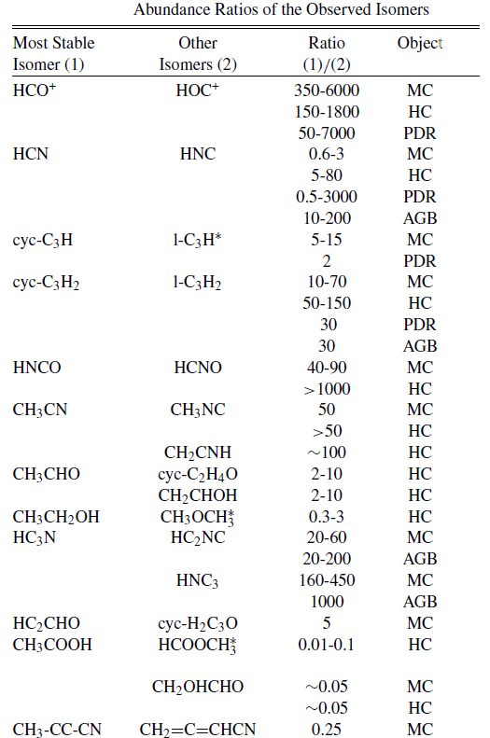
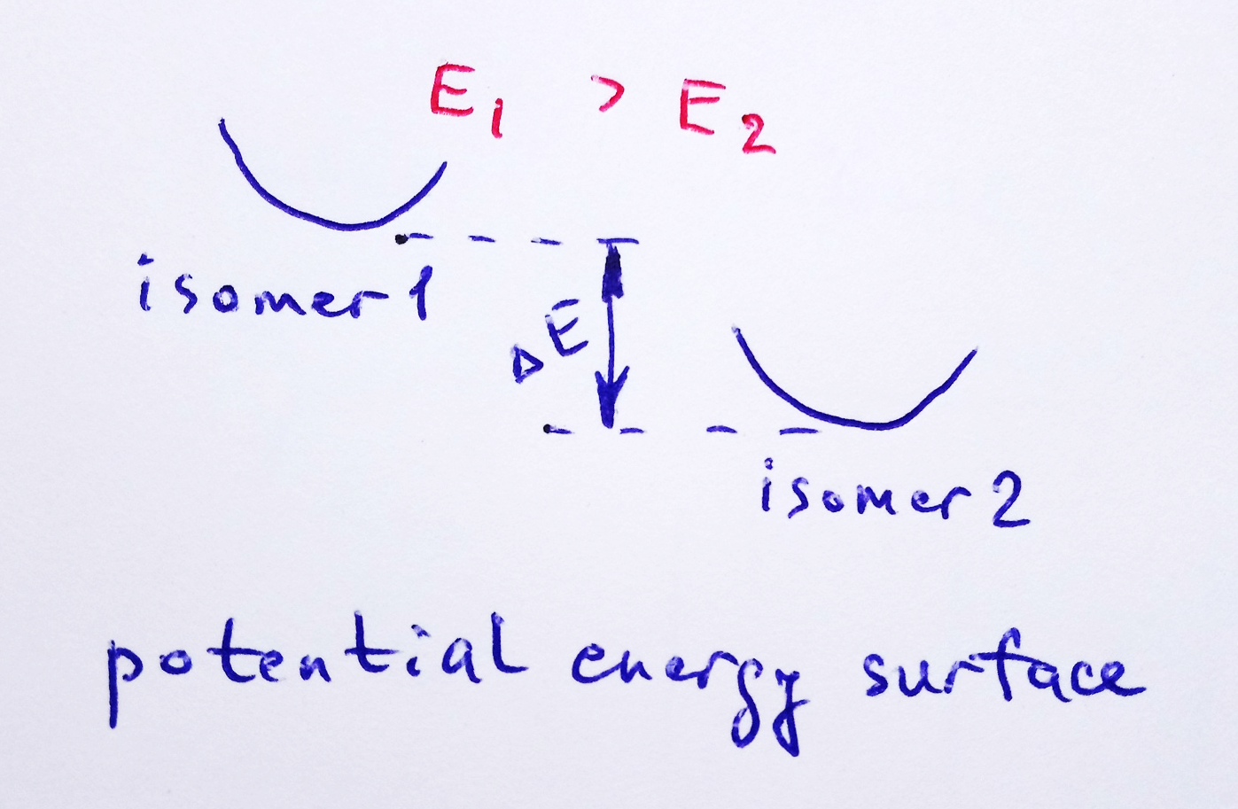
The list of ISM contains the isomeric series
The isomer with minimal total energy is thermodynamically more favorable and expected to be more stable and, hence, more achievable under laboratory conditions or natural environment
Lattelais et al., ApJ. 696 (2009) L133

Slide 4

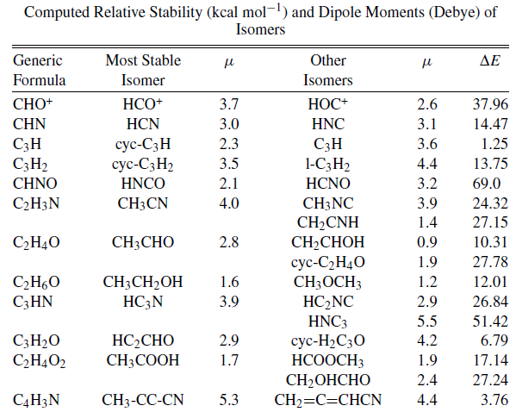

Minimum energy principle (MEP) applied to ISM isomeric compounds
Applied to astrochemical issues:
Remijan et al., ApJ. 632 (2005) 333;
Lattelais et al., ApJ. 696 (2009) L133; A&A 519 (2010) A30; PCCP 12 (2010) 4165;
Karton & Talbi, Chem. Phys. 436-437 (2014) 22.
B3LYP/cc-pVQZ // CCSD(T)/cc-pVQZ calculations

Slide 5
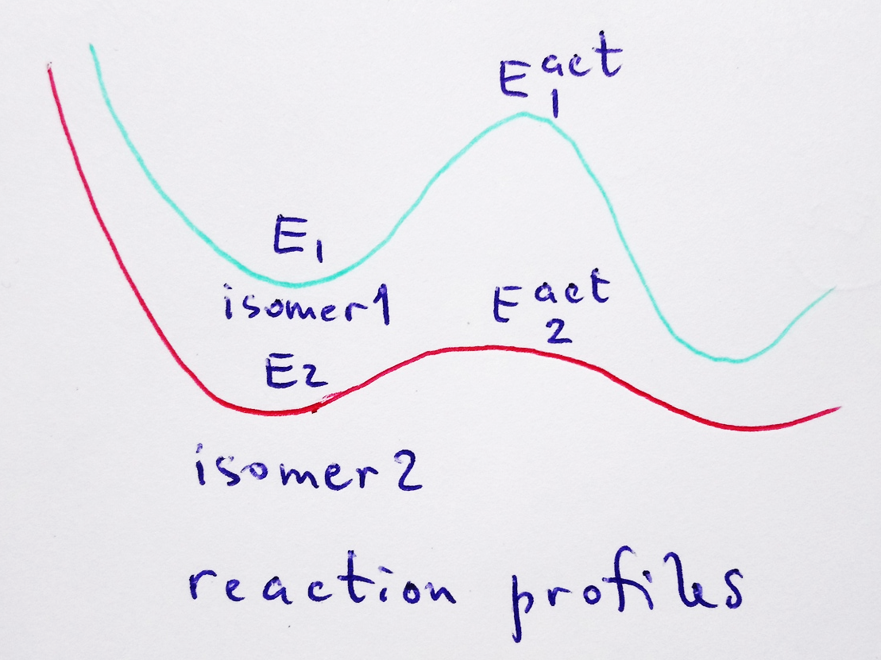
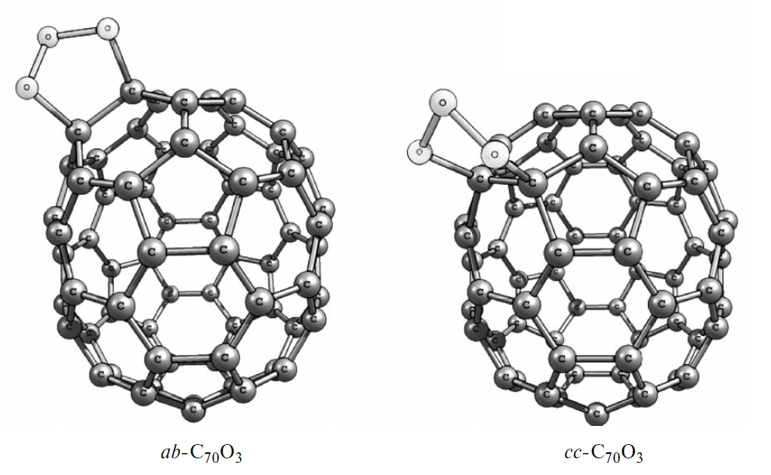
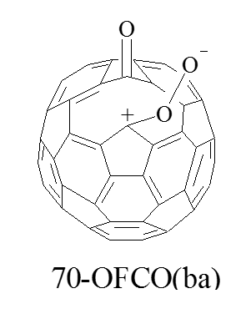
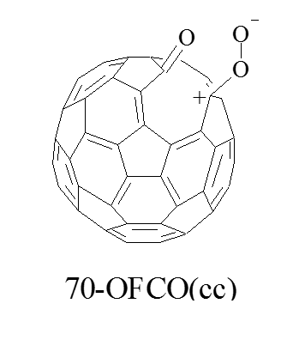
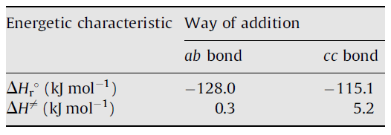
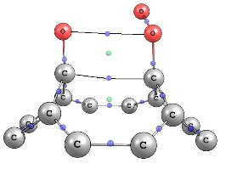
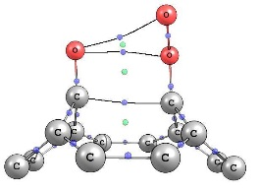
One example from laboratory chemistry of fullerenes
14 min (23°C)
650 min (23°C)
Mean polarizability (Å³) 105.7 104.8
Experiments – Heymann et al., FNT 12 (2004)
Theory – Sabirov et al., JMGM 27 (2009) 124;
Refining Experiments - Sabirov et al.,
Mendeleev Commun. 20 (2010) 231

Slide 6
A brief note to polarizability
Dipole polarizability defines the dipole moment of an atom/molecule induced by the external electric field.
up to
E = 10⁵ V cm⁻¹
Mean polarizability
Anisotropy of polarizability
Units: 1 a.u. = 0.148 Å³ = 1.6488·10^{–41} C² m² J^{–1}

Slide 7
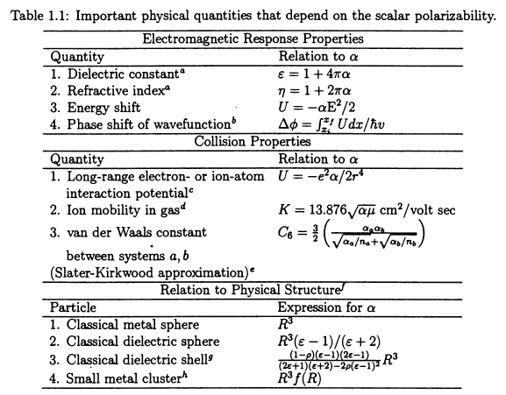
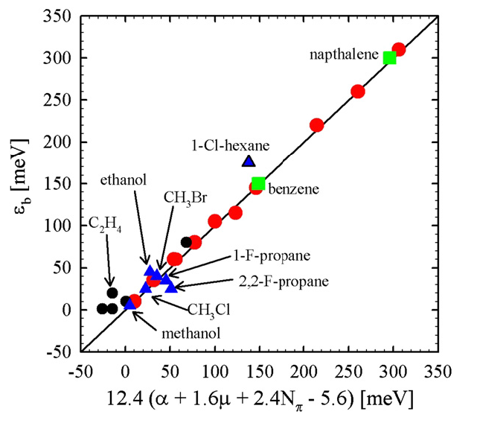
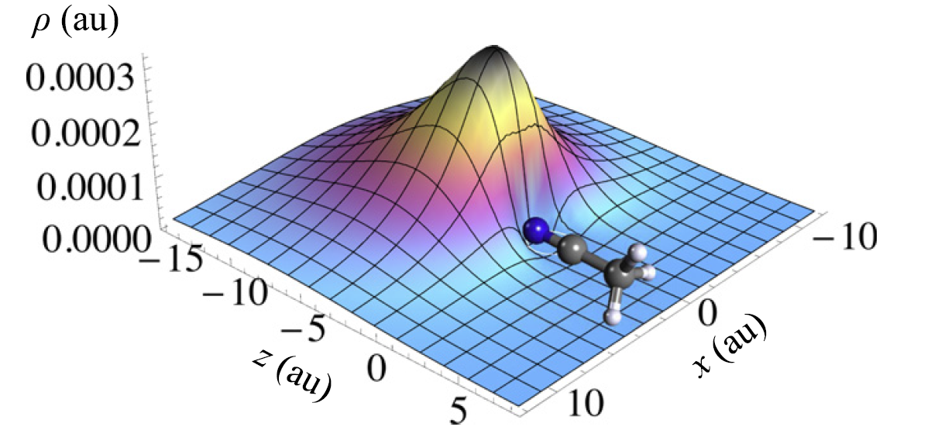
Physical quantities and processes defined by polarizability
Polarizability relates to interaction of organic compounds with elementary particles, e.g., positrons
Bonin & Kresin, Electric-Dipole polarizabilities of atoms, molecules and clusters. World Scientific, 1997.
Danielson et al., J. Phys. B 42 (2009) 235203
CH₃CN molecule in the electric field of positron
Gribakin & Swann, J. Phys. B 48 (2015) 215101

Slide 8
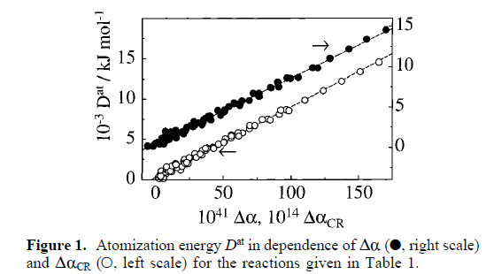

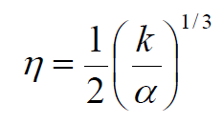
Minimum polarizability principle (MPP)
The most stable isomer should have the lowest mean polarizability in the isomeric set.
Exothermic reactions should decrease the total polarizability of molecular system (and endothermic ones increase).
Holm, J. Phys. Chem. A 104 (2004) 8418
Ghanty & Ghosh, J. Phys. Chem. 100 (1996) 12295
MPP may be violated
For atoms
Hati & Datta, J. Phys. Chem. 98 (1994) 10451
Blair & Thakkar, Chem. Phys. Lett. 556 (2013) 346

Slide 9
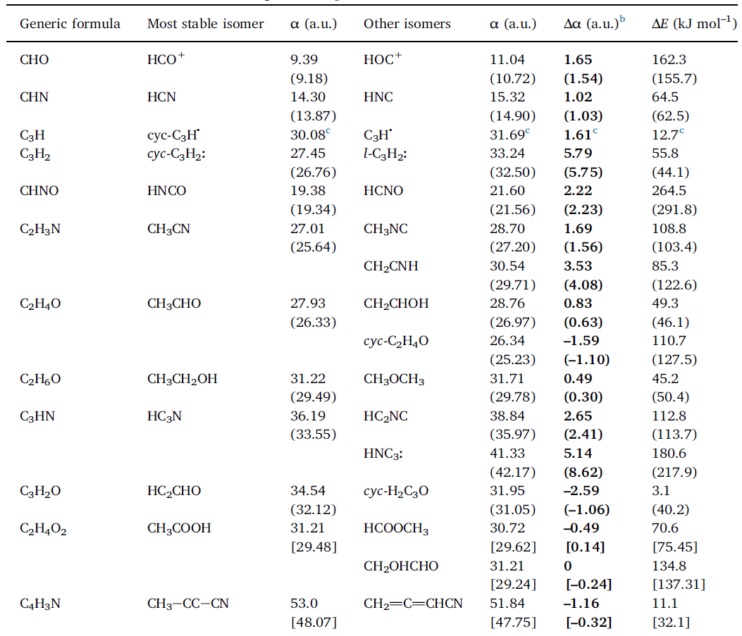
MPP applied to isomeric ISM species
PBE, CCSD(T) (in parentheses), and RI-MP2 (in brackets) in combination with the Λ22m basis set (Priroda 11 program)
MEP and MPP are consistent in most cases
ΔE_{stable} < ΔE_{other}
α_{stable} < α_{other}
A good mismatch!
Sabirov, Garipova, Cataldo, Mol. Astrophys. 12 (2018) 10

Slide 10
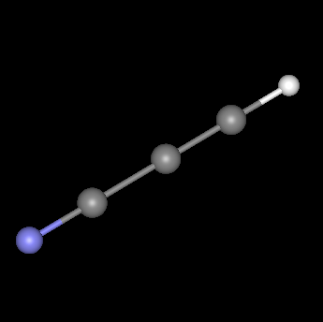
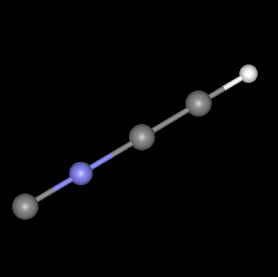
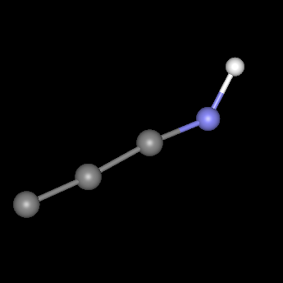
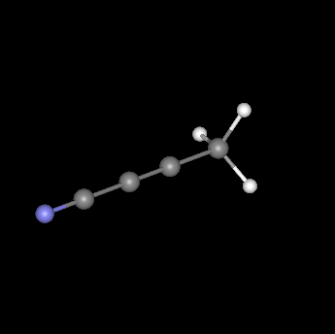
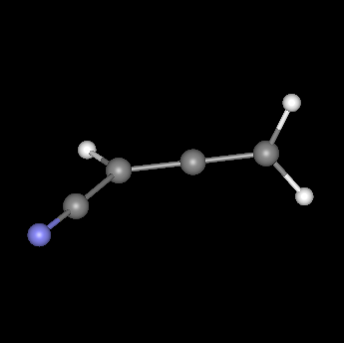
Minimum polarizability principle: Examples
◄ The C₃HN set
36.19 a.u.
38.84 a.u.
41.33 a.u.
0.0 kJ mol⁻¹
112.8 kJ mol⁻¹
180.6 kJ mol⁻¹
ΔE↓ α↓ abundance↑
CW Leonis (IRC+10216)
5.9×10¹⁴ cm⁻²
3.6×10¹² cm⁻²
0.4×10¹² cm⁻²
Column densities from Gensheimer, Astrophys. Space Sci. 251 (1997) 199
◄ The C₄H₃N set
53.0 a.u.
51.84 a.u.
ΔE↓ α↓ abundance↑
0.0 kJ mol⁻¹
11.1 kJ mol⁻¹
Taurus molecular cloud (TMC-1)
4.5×10¹¹ cm⁻²
2.0×10¹² cm⁻²
Column densities from Lovas et al., ApJ Lett. 637 (2006) L37

Slide 11
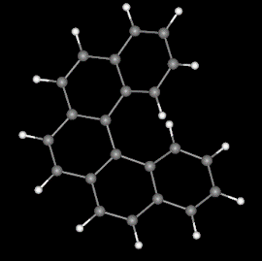
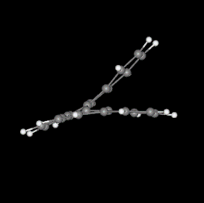
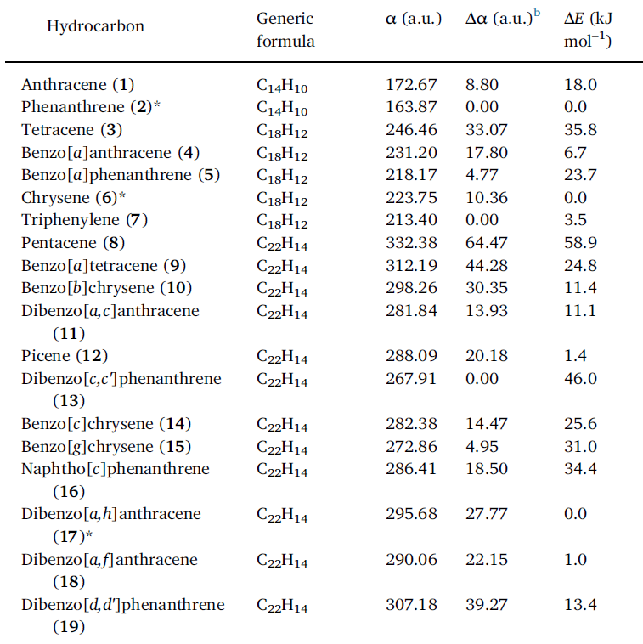
MEP + MPP: Isomeric polycyclic aromatic hydrocarbons
MEP
MPP
MPP
MEP
MPP
MPP
MEP
MEP
MEP
Sabirov, Garipova, Cataldo, Mol. Astrophys. 12 (2018) 10

Slide 12
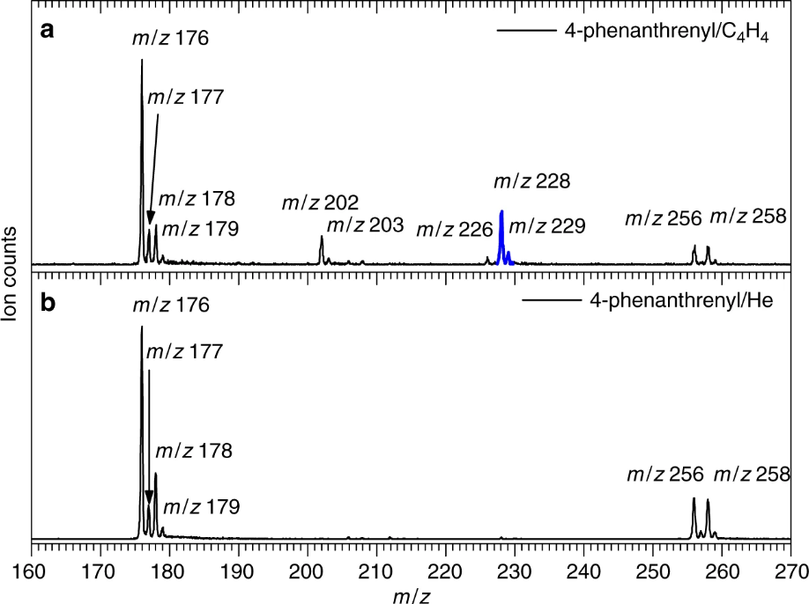
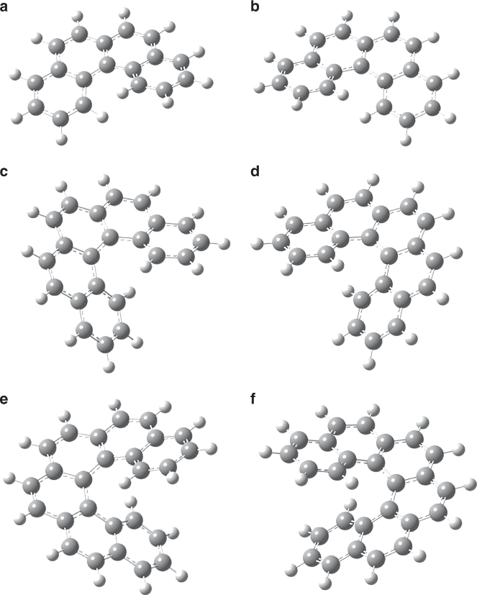
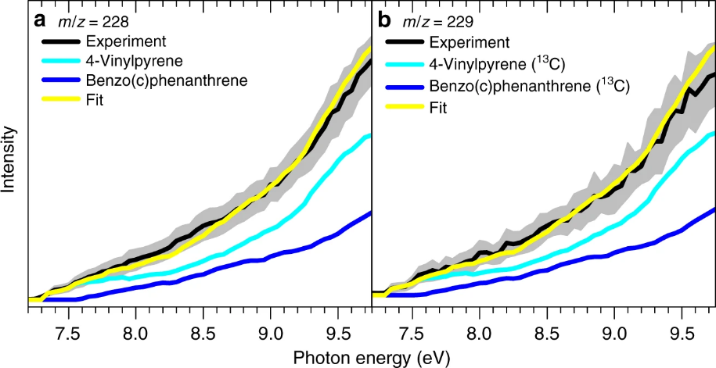
[4]Helicene synthesis under CSE carbon-rich stars conditions
[4]H
[5]H
[6]H
4-Phenanthrenyl + vinylacetylene -> [4]H
Synthesis + mass-spectrometry + photoionization efficiency spectra
Zhao et al., Nature Commun. 10 (2019) 1510

Slide 13
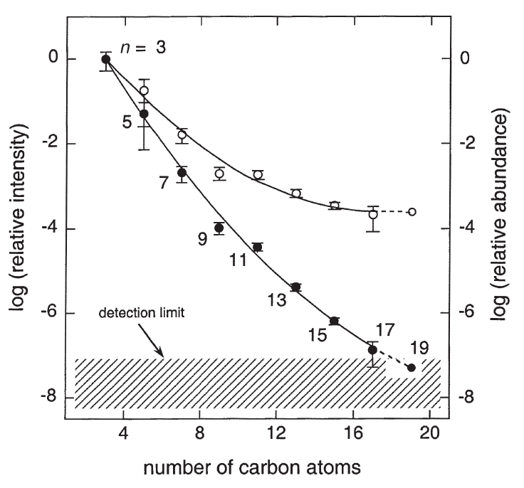
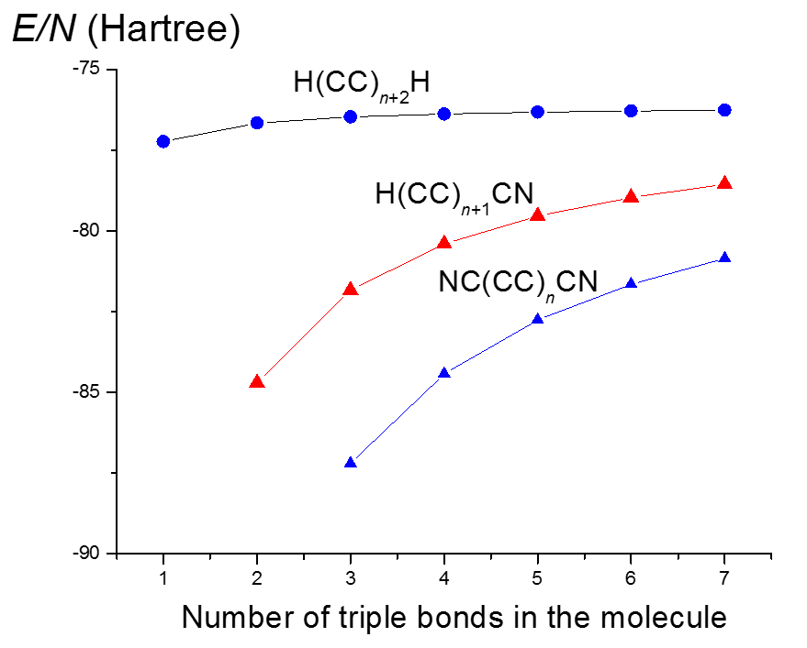
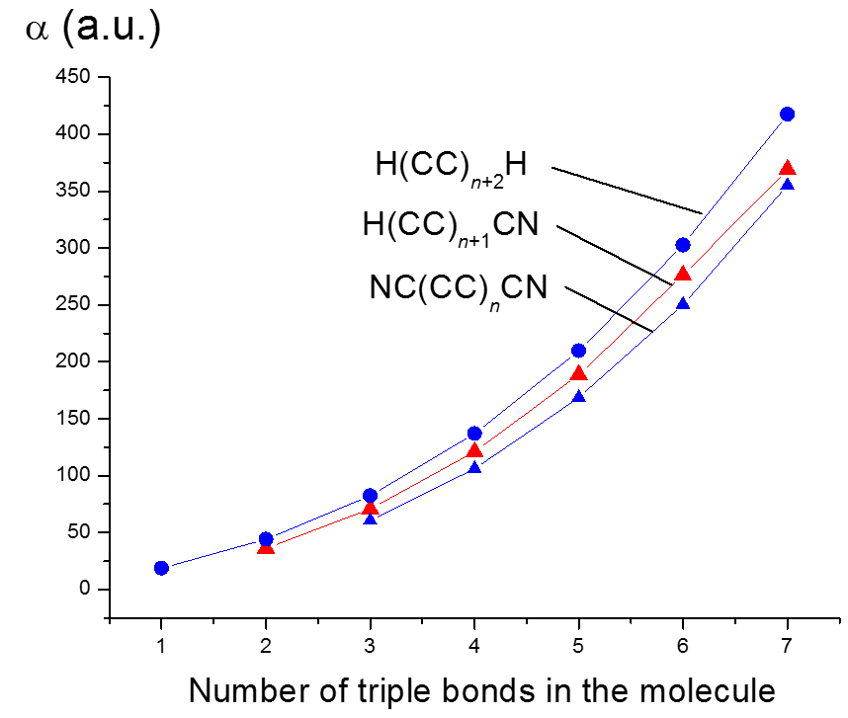
Energy + Polarizability: Polyynes, cyano-, and dicyanopolyynes
McCarthy & Thaddeus, 2001
The PBE/Λ22m computations
The yields of polyynes and cyanopolyynes decease with the molecular size
Cataldo, 2004, 2006, 2007; McCarthy & Thaddeus 2001; Agundez 2017

Slide 14
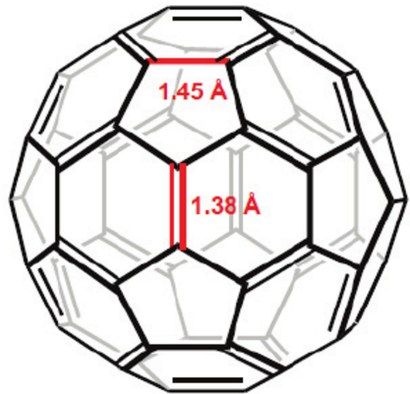
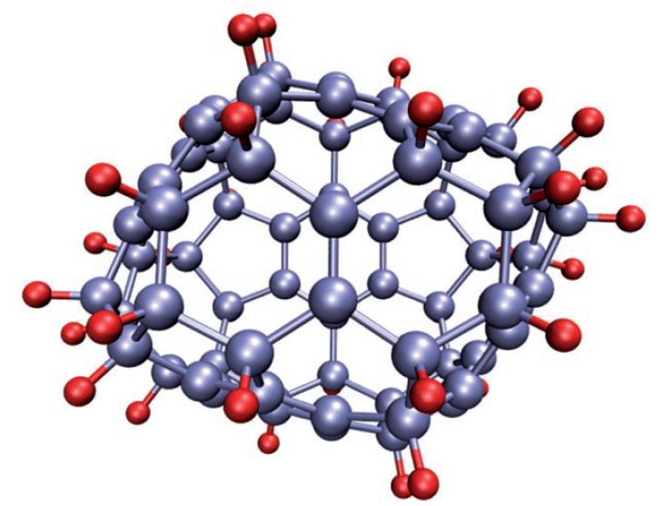
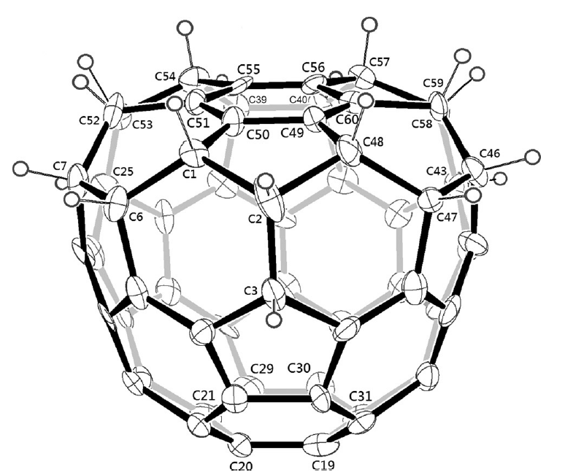
Fullerene hydrides: A challenge
+ H₂, H•, …
Webster, MNRAS 257 (1992) 463.
Webster, MNRAS 262 (1993) 831.
Cataldo & Iglesias-Groth, MNRAS 400 (2009) 291.
Cataldo & Iglesias-Groth, Fulleranes: the hydrogenated fullerenes, Springer, 2010.
Iglesias-Groth et al., MNRAS 423 (2012) 2868.
Diaz-Luis et al., A&A 589 (2016) A5.
Zhang et al., J. Phys. Conf. Ser. 728 (2016) 052004.
C₆₀ has 30 double bonds ready for hydrogenation
Easy in theory, hard in experiment!
C₇₀H₃₈
C₆₀H₁₈
C₆₀H₄₂ and C₇₀H₄₄
are the highest hydrogenated derivatives.
Goldshleger & Moravsky, Russ. Chem. Rev. 66 (1997) 323
Wågberg et al., Angew. Chem. Int. Ed. 47 (2008) 2796
Chen et al., Chem. Eur. J. 21 (2015) 17229

Slide 15
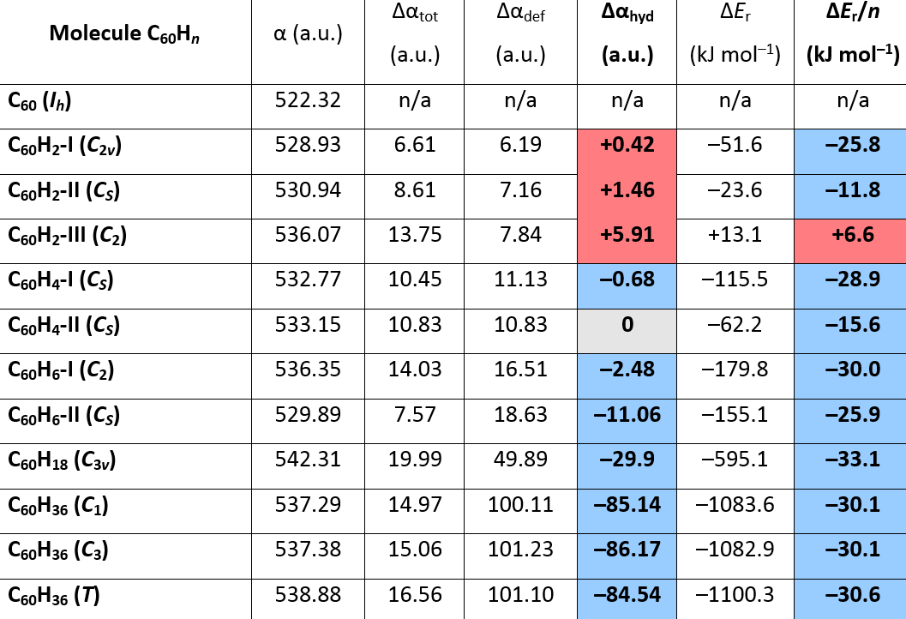
Fullerene hydrides: Choosing the structures
ΔE_{r} = E(C₆₀H_{n}) – [E(C₆₀) + n/2×E(H₂)]
Δα_{tot} = α(C₆₀H_{n}) – α(C₆₀)
Δα_{tot} = Δα_{def} + Δα_{hyd}
Sabirov, Garipova, Cataldo, Mol. Astrophys. 12 (2018) 10

Slide 16
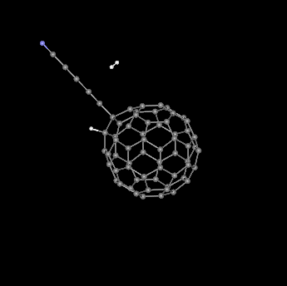
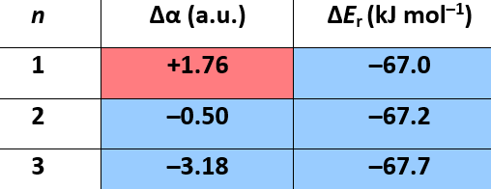
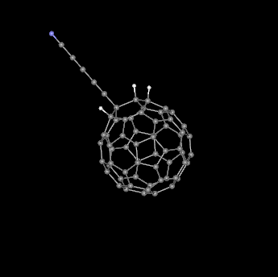
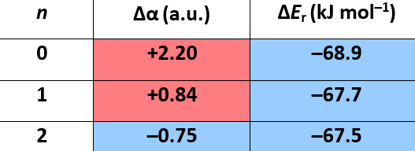
Hydrogenation of the C₆₀ fullerene cage: May be within more complex compounds?
Estimated with the PBE/3ζ method, preliminary calculations
Fullerene-polyyne adducts
H(C≡C)_{n}C₆₀H + H₂ → H(C≡C)_{n}C₆₀H₃
Fullerene-cyanopolyyne adducts
NC(C≡C)_{n}C₆₀H + H₂ → NC(C≡C)_{n}C₆₀H₃

Slide 17
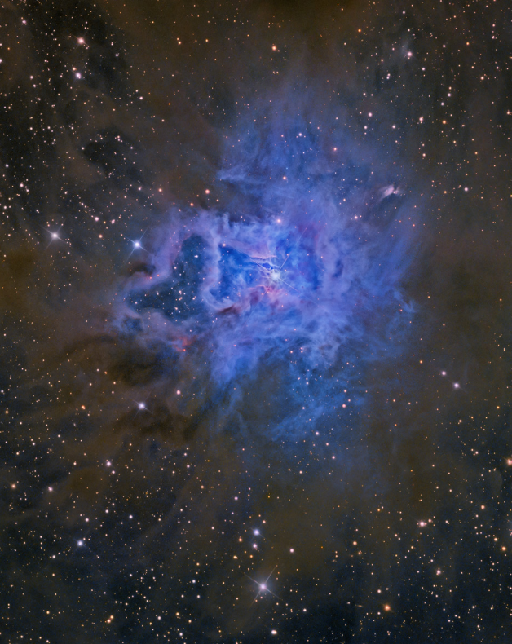
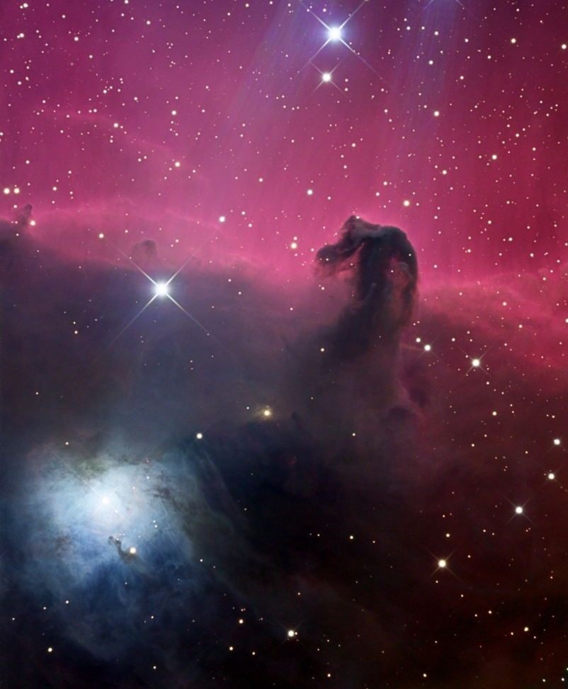
Fullerenes in space: Structural descriptor approach
Reflection Nebula NGC 2023 (constellation Orion)
Iris Nebula NGC 7023 (constellation Cepheus)
Cami et al. 2005, 2010
C₆₀ ≈ 5.8×10^{－8} M⦿
  C₇₀ ≈ 4.7×10^{－8} M⦿
Sum ≈ 10^{－7} M⦿=10²⁰ tons (M⦿ = 1.99×10³⁰ kg)
Fullerenes occupy about 1.5% of the whole carbon emission. Relative amount of C₇₀ higher than on earth.
Garcia-Hernandez et al. 2010-2012
C₆₀/C₇₀ found in 10 places of Galaxy and Small Magellanic Cloud

Slide 18
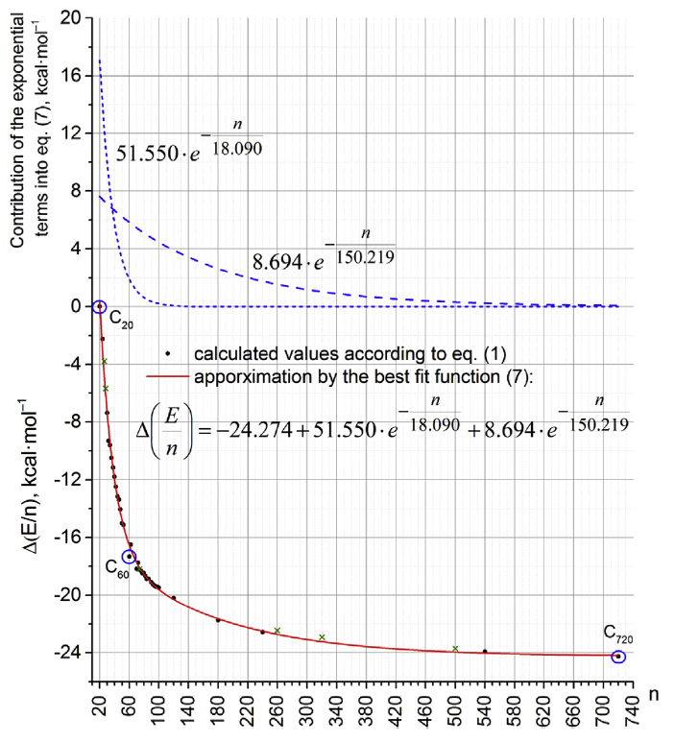

The Fullerenes: Thermodynamics
C₇₀ is thermodynamically more stable than C₆₀
Δ_{f}H°₂₉₈
PBE/3ζ method
C₇₀
604.68±3.11
658.46±5.50
~10.1
per atom
~9.4
per atom
(values in kcal mol⁻¹)
Beckhaus et al., Angew. Chem. Int. Ed. 33 (1994) 996;
Diky & Kabo, Russ. Chem. Rev. 69 (2000) 95 – a review;
Bumpus, J. Phys. Chem. A 122 (2018) 6615.
Pankratyev, Khatymov, Sabirov, Physica E 101 (2018) 265

Slide 19
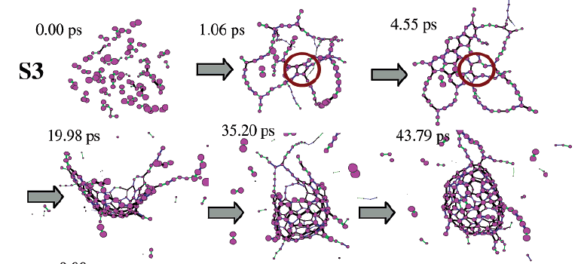
The fullerenes: Molecular dynamics simulations
Irle & Morokuma, 2006

Slide 20
Information-topological approach
- Information entropy (Shannon, 1926)
p_{i} are the probabilities to find the atom of i-th atom type.
Bonchev, Bulg. Chem. Commun. 28 (1995) 57
Sabirov, Comput. Theor. Chem. 1123 (2018) 169
To calculate h values, we just need to know the distribution of the atoms over the atom types, or NMR pattern.
More symmetric molecules obtain lower h values;
symmetry breakdown leads to the increase in the information entropy.

Slide 21
Information entropies of 2079 fullerene structures
0.67%
of 2079 str-res
C₂₈-2, C₃₂-5, C₃₆-13, C₃₆-15, C₄₀-39, C₄₄-73, C₄₈-186, C₄₈-189, C₅₀-271, C₇₂-1, C₈₄-20, C₈₄-24 – 12 fullerenes
Sabirov & Osawa, J. Chem. Inf. Model. 55 (2015) 1576

Slide 22
Conclusions
Joint use of energetic parameters, physicochemical properties, and structural descriptors provides more accurate theoretical description of astrochemistry.

Slide 23
Thank you for your attention!

