Slide 1
Astrochemistry towards Seeds of Life
Masatoshi Ohishi (NAOJ)
collaborators: T. Suzuki , M. Saito, T. Hirota,
H. Nomura, H. Minamoto and N. Kaifu
masatoshi.ohishi@nao.ac.jp

Slide 2
Elemental Abundance (Si=1)
Element | Abundance | Element | Abundance
H | 28000 | Si | 1
He | 2700 | P | 0.008
Li | 0.0000004 | S | 0.45
Be | 0.0000004 | Cl | 0.009
B | 0.000011 | Ar | 0.1
C | 10 | K | 0.0037
N | 3.1 | Ca | 0.064
O | 24 | Sc | 0.000035
F | 0.001 | Ti | 0.0027
Ne | 3 | V | 0.00028
Na | 0.06 | Cr | 0.013
Mg | 1 | Mn | 0.0069
Al | 0.083 | Fe | 0.9

Slide 3
H, C, N, O are the top 4
elements in the Universe
We (life) were born by
utilizing abundant elements
in the Universe

Slide 4
Complex Organic Molecules in Star Forming Regions
H₂CO
CH₃OH
C₂H₅OH
CH₃COOH
HCOOCH₃
(CH₃)₂O
(CH₃)₂CO
CH₂OHCHO
CH₂NH
CH₃NH₂
CH₂NH₂CN
~ 100 COMs

Slide 5
CH₃OH on Small Solar Bodies
H₂O-CH₃OH ice
ν4, ν5, ν9, ν10
CH₃OH absorption on Trans-Neptunian Objects (TNO)
Primordial material when the object was formed
F. Merlin et al., A&Ap, 544, A20 (2012)

Slide 6
Secure Detection of Glycine in Comet 67P
Altwegg et al., Sci. Adv., 2, e1600285 (2016)

Slide 7
Formation of Organic Material
From Ehrenfreund et al. (2002), Table 6

Slide 8
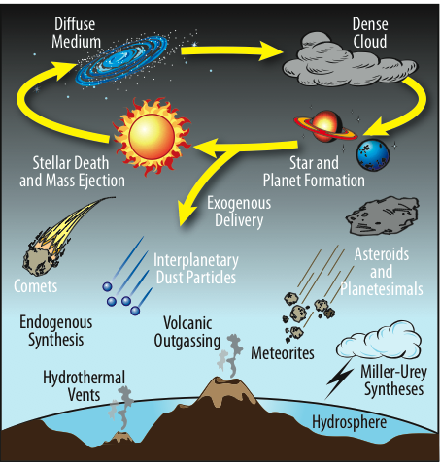
Stars, Planets, and Life
x1000 more
organic material
Observations
& Simulations
Lab Analysis
Simulations
Notes:
Where did ingredients of life originate? Planetary system formation; some material survived and was incorporated into small bodies, eventually delivered to planetary surfaces. Observations/simulations tell us about what might have been present initially.

Slide 9
Prebiotic Species in Space
Sugars
Glycolaldehyde
Amino acids
Glycine, Alanine (trials only)
Amonoacetonitrile
Nucleic acids
No searches
Trials for their building blocks pyrimidine, imidazole, pyrrole,,,

Slide 10
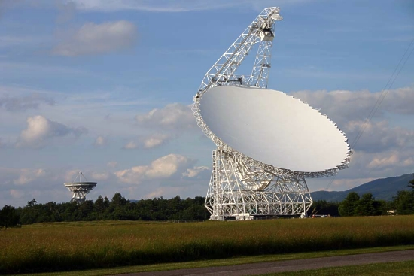
Green Bank Telescope, WV, USA

Slide 11
Glycolaldehyde by GBT
(H₂CO)₂
Four transitions
High S/N
LSR velocities are consistent
(Hollis et al. (2004), ApJ, 613, L45)

Slide 12
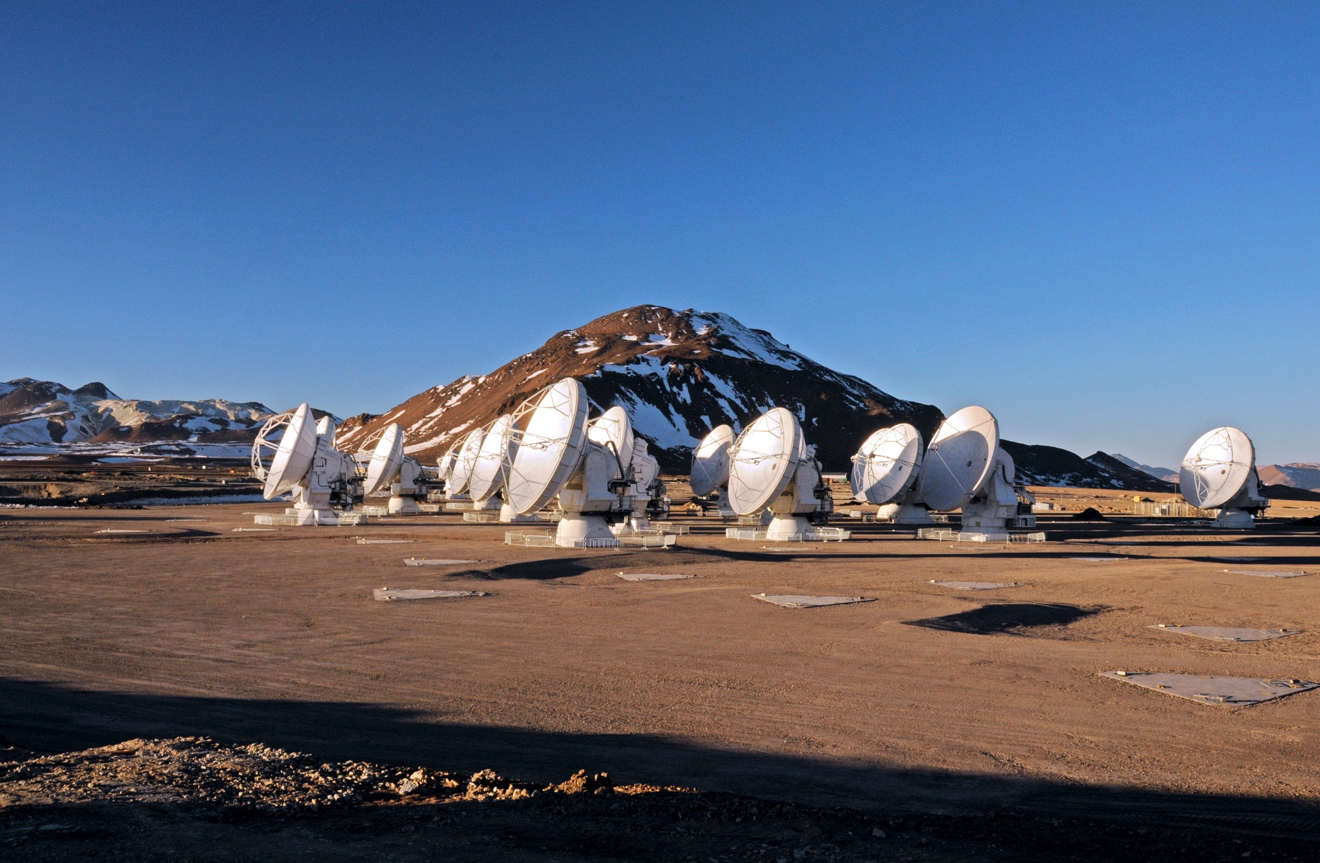
ALMA (Atacama Large Millimeter/submillimeter Array)
Int. Collaboration – Japan/N.A/Europe
30~950 GHz, max. resolution ～0.1 sec for line obs.
© ALMA (ESO/NAOJ/NRAO)

Slide 13
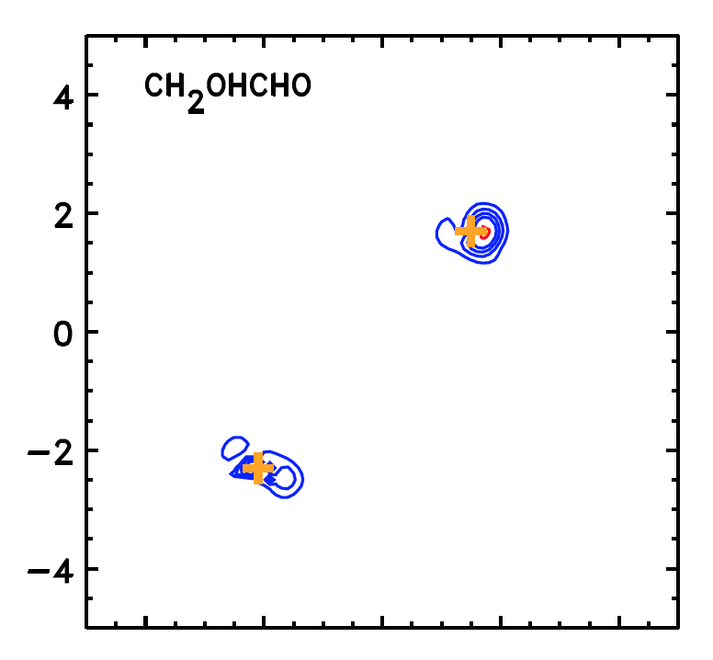
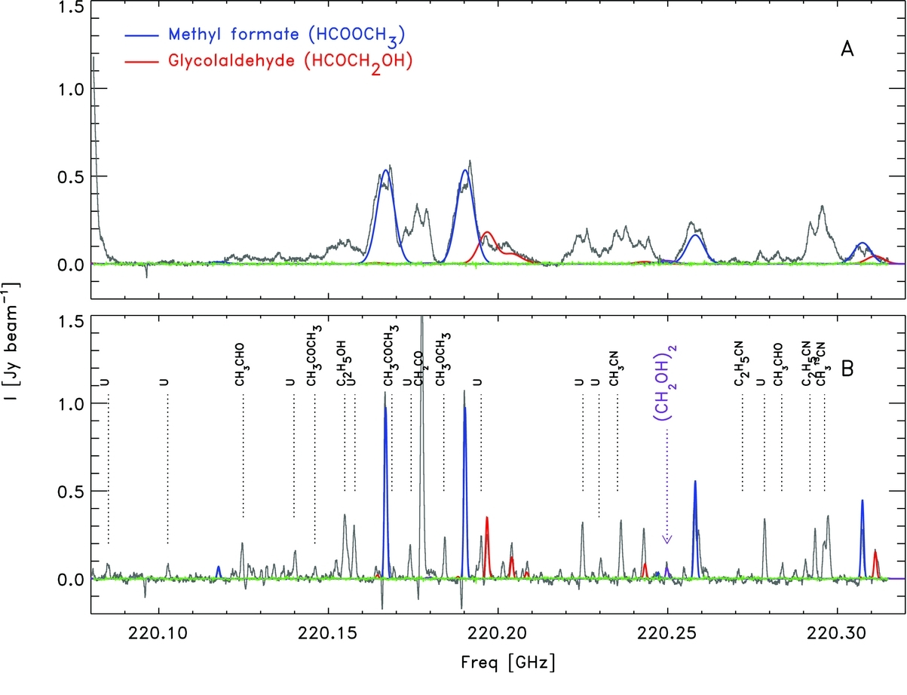
ALMA: Glycolaldehyde at a Sun-like protostar
(Jørgensen et al. 2012)

Slide 14
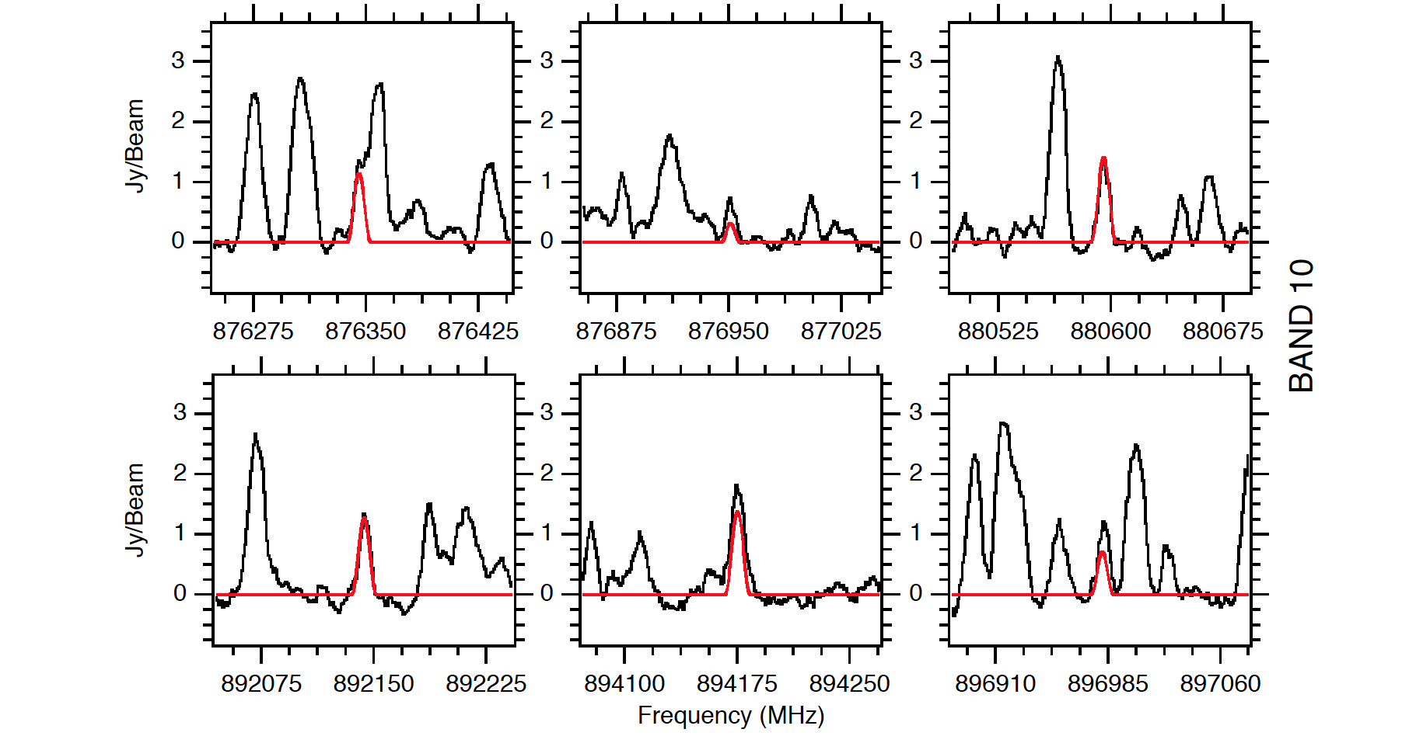
ALMA: Glycolaldehyde at a high-mass star
forming region, NGC6334I (McGuire et al. 2018)
Glycolaldehyde is widespread in our Galaxy.

Slide 15
Prebiotic Species in Space
Sugars
Glycolaldehyde
Amino acids
Glycine, Alanine (trials only)
Amonoacetonitrile
Nucleic acids
No searches
Trials for their building blocks pyrimidine, imidazole, pyrrole,,,

Slide 16
History of Glycine Search
Brown et al. (1979)
Combes et al. (1996)
Ceccarelli et al. (2000)
Hollis et al. (2003a,b)
Kuan et al. (2003) claimed first detection
disputed by Snyder et al. (2005)
denied by Jones et al. (2007); Cunningham et al. (2007)

Slide 17
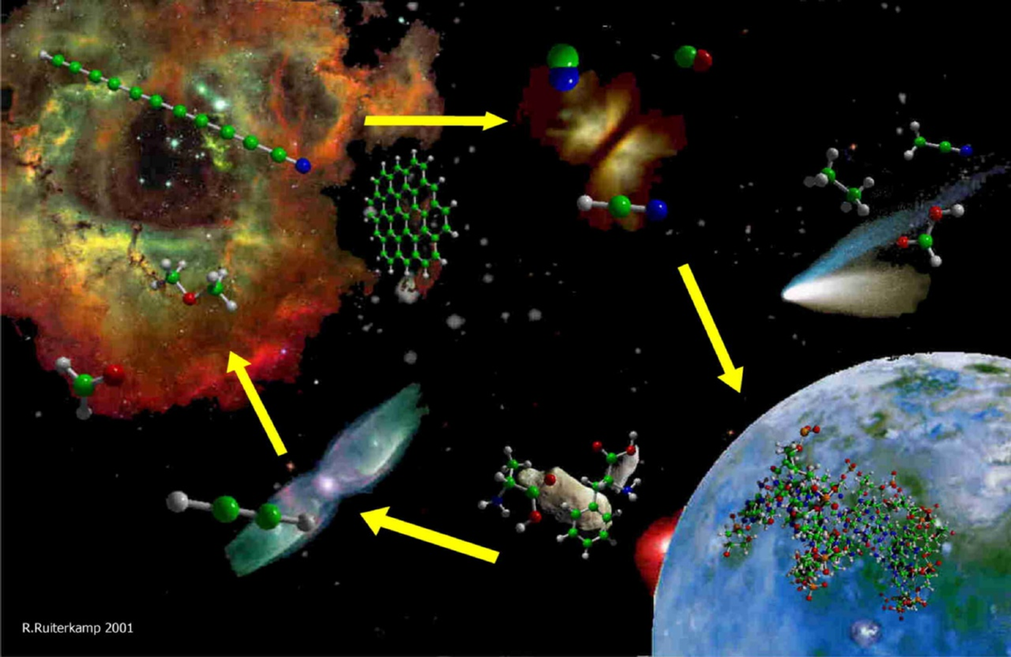
Are there amino acids in the interstellar molecular clouds ?
precursors to amino acids

Slide 18
Glycine Formation on Ice
Holtom et al. ApJ, 626, 940 (2005)
Reaction between CH₃NH₂ and CO₂
CH₃NH₂ + CR → CH₂NH₂ / CH₃NH + H
CO₂ + H → HOCO
NH₂CH₂ + HOCO → NH₂CH₂COOH
CH₃NH + HOCO → CH₃NHCOOH
Confirmed on ice (lab.) and by quantum chemical calculations (gas phase !)
Kim & Kiser, ApJ, 729, 68 (2011) observed CH₃NH₂ on ice with NH₃/CH₄ (lab)

Slide 19
Assumed Formation Paths in the Interstellar Matter
On ice with UV irradiation
Holtom et al. (2005)
Kim & Kaiser (2011)
Theule et al. (2011)
Belloche et al. (2008)
Rich in interstellar molecular clouds

Slide 20
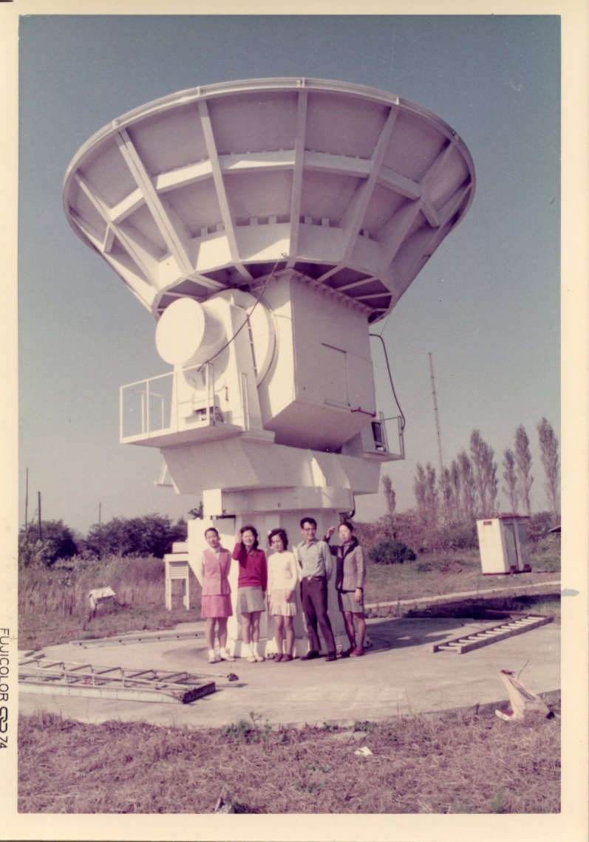
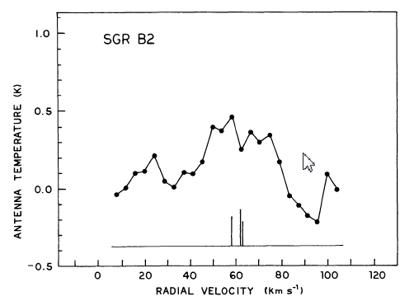
CH₃NH₂
Detected by Kaifu et al. (1974) towards only in Orion KL, SgrB2
Many lines observed in SgrB2, but no confirmation in Orion KL.
Only a few observations were conducted so far.

Slide 21
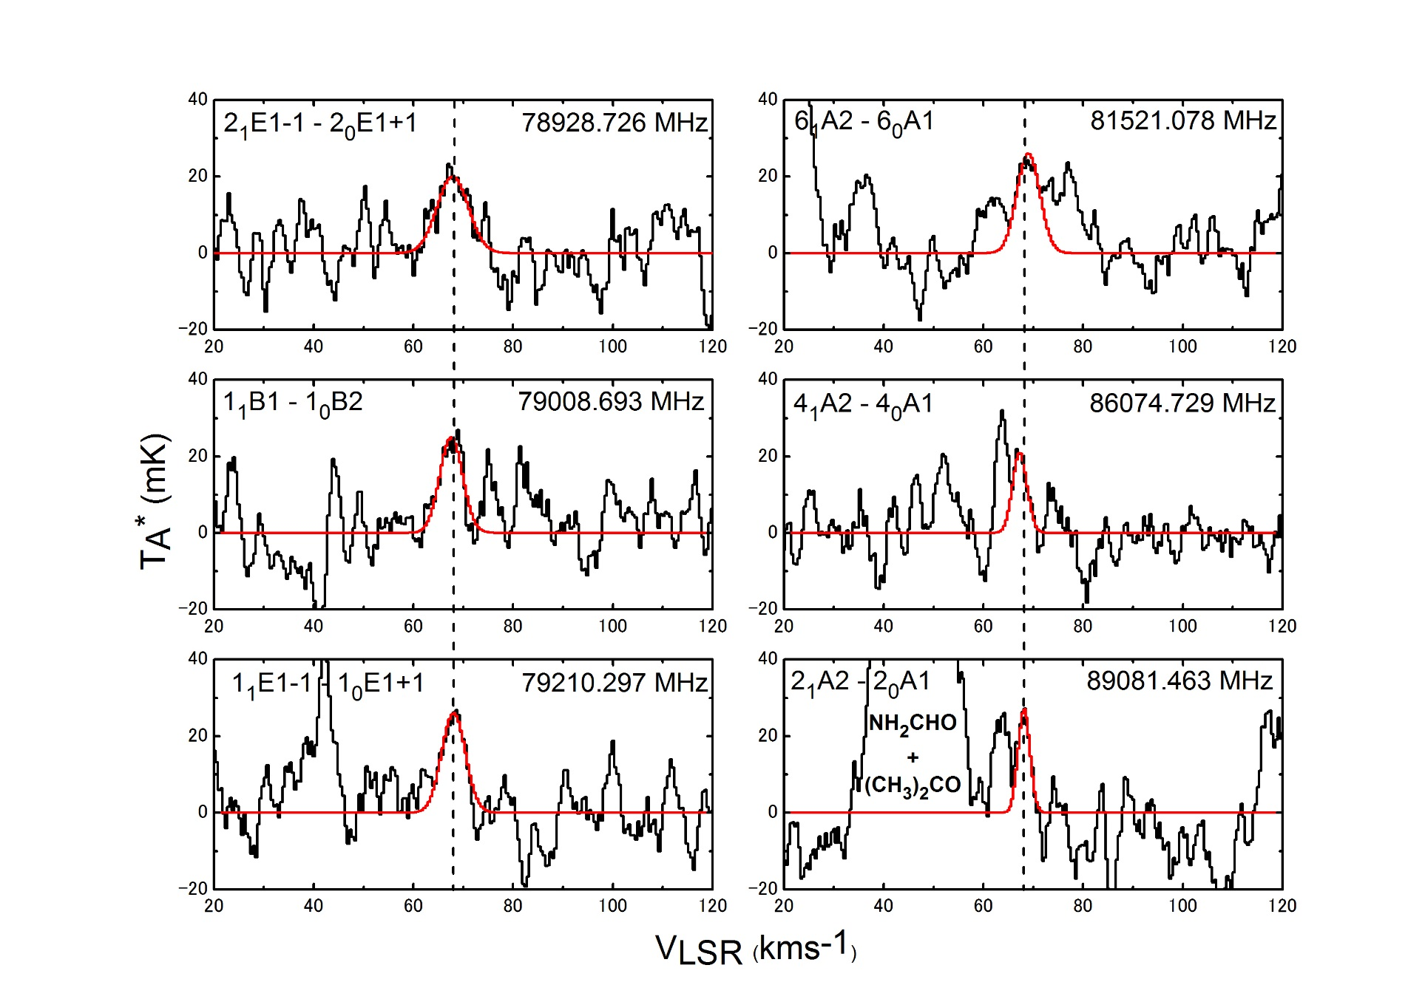
CH₃NH₂ in G10.47+0.03
Ohishi et al., 2019

Slide 22
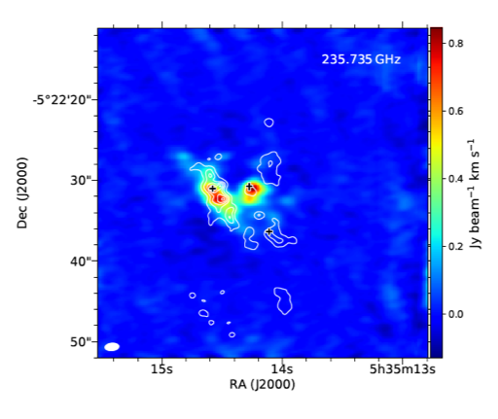
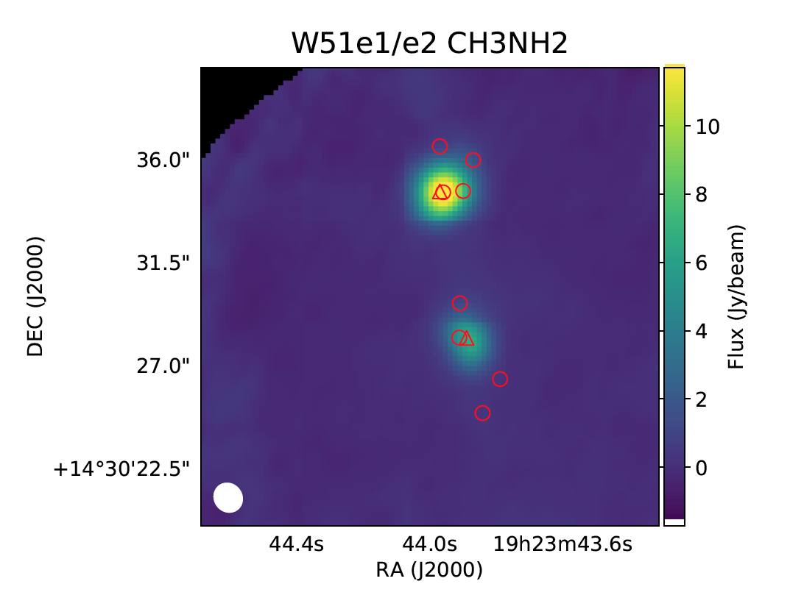
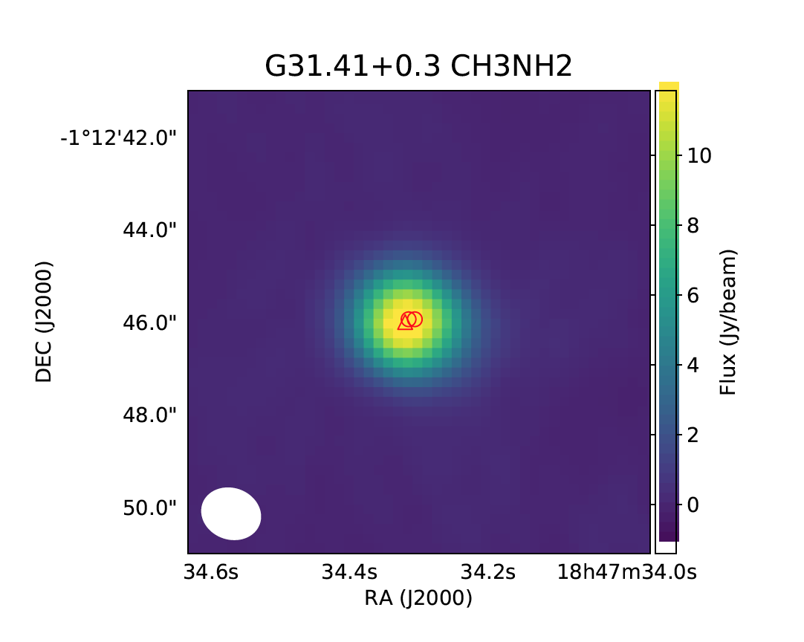
More New CH₃NH₂ Sources by ALMA
NGC6334I (Bøgelund et al., 2019)
Confirmation in Orion KL
Minamoto et al.,
Master’s thesis
(2019)
Consistent with
Pagani et al. 2017
W51 e2 and e8, and G31.41+0.3
(Suzuki et al., 2019, submitted to ApJ)

Slide 23
Current Summary of CH₃NH₂ observations (hot cores)
Source | Fractional abundance (CH₃NH₂/H₂)
SgrB2 (N) | 1.7 (-9)
G10.47+0.03 (core) | 1.5 (-7)
(envelop) | 1.5 (-8)
G31.41+0.3 | 4.3 (-8)
W51 e2 | 2.1 (-8)
W51 e8 | 6.1 (-8)
NGC6334I MM1 | 5.6 (-8)
MGC6334I MM2 | 5.7 (-8)
Orion KL | 3.2 (-9)
$$f\left(CH_{3}NH_{2}\right)\sim {10}^{−8}$$
a (b) denotes a x 10^{b}

Slide 24
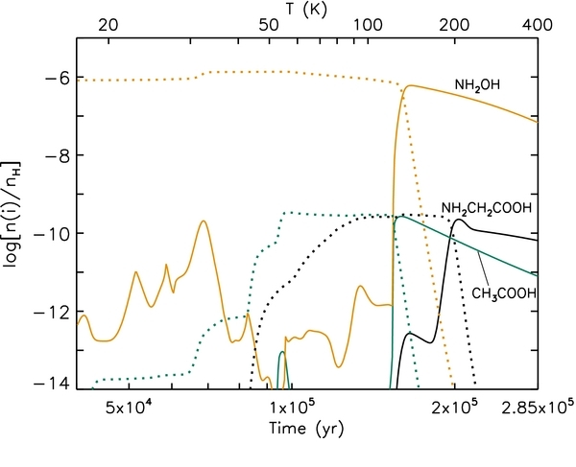
Simulation on Glycine Formation
incorporates CH₃NH₂ + CO₂ -> glycine
formation
sublimation
From Figure 4 of Garrod 2013 ApJ 765 60

Slide 25
Prebiotic Species in Space
Sugars
Glycolaldehyde
Amino acids
Glycine, Alanine (trials only)
Amonoacetonitrile
Nucleic acids
No searches
Trials for their building blocks pyrimidine, imidazole, pyrrole,,,

Slide 26
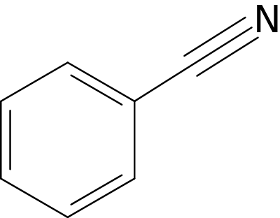
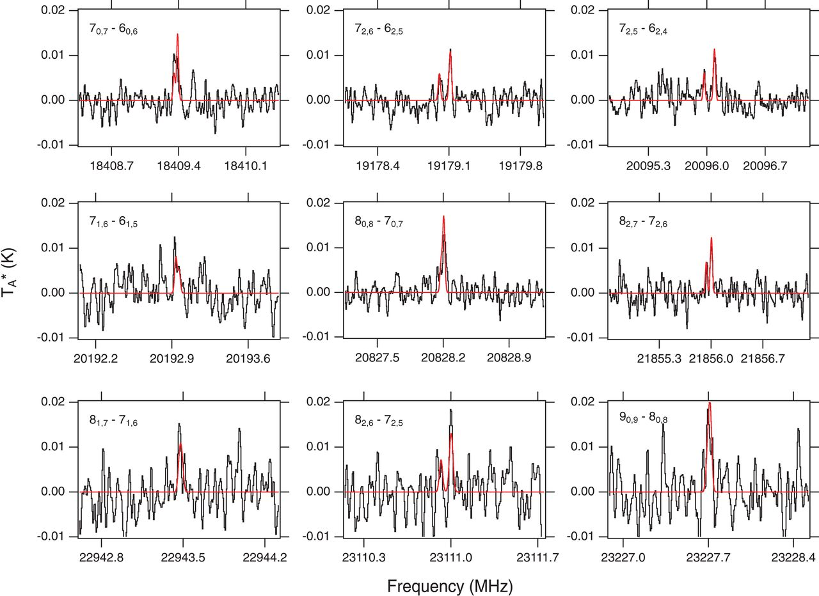
Detection of benzonitrile in TMC-1
T~10K !
Brett A. McGuire et al. Science 2018;359:202-205
Notes:
Detected emission lines of benzonitrile in TMC-1. Observational spectra are shown in black smoothed to a resolution of 5.7 kHz (0.08 km s^{–1}) and shifted to a v_{lsr} value of 5.83 km s^{–1}. A simulated spectrum of benzonitrile (linewidth = 0.4 km s^{–1}, N_{T} = 4 × 10¹¹ cm^{–2}, T_{ex} = 7 K) is overlaid in red (25). Rotational quantum numbers are displayed at the upper left of each panel. The four transitions with well-resolved hyperfine structure are shown on an expanded frequency axis in (25).

Slide 27
Summary
In star forming regions, prebiotic molecules are widespread: Glycolaldehyde, CH₃NH₂, CH₂NH and others.
A ring molecule that may be related to precursors to nucleic acids has been discovered in a cold, dark cloud.
It is plausible that interstellar glycine exists in star forming regions; ALMA observations will tell its existence.
Issue: hard to know how much ISM-born organic molecules
are incorporated into and kept in comets, meteorites, IDPs…

