Slide 1

Probing the periodic table
in the outer halo
Probing the outer halo
with the periodic table
Andreas Koch
&
P. Côtè (DAO, UVic)
“The periodic table through space and time”, St. Peterburg, Sep. 12, 2019
Notes:
PT won't look different in the OH, but use it to probe the OH!

Slide 2
- Historically, GCs were considered “mono-metallic”:
[X/H] ~ const. within each system.
- Now: GCs host multiple pop’s; phot. evidence and light- element (CH/CN; Na-O) variations. (Osborne 1971; Cohen 197N; Gratton et al. 2012)
- Define “...GCs as the stellar aggregates showing the Na-O anticorrelation.” (Carretta et al. 2010)
Your average Globular Cluster
  GCs
  MW field,
  dSphs
Carretta et al. 2009
  (Geisler et al. 2007)
Not found in field stars, dwarf galaxies, (open clusters).
Notes:
See yesterday's talk by Dongwook Lim
Simple Stellar Populations
100thousands of stars, all at same distance, all born out of the same cloud, SSP!
GCs, in particular the more massive ones
2 generations, separated by only xy Myr
There is still a lot to learn and models nee to be improved,

Slide 3
GC–field connection
Generally, GCs follow the abundance trends of the surrounding field → they are excellent tracers of the Galactic components. Outliers are potentially accreted.
[α/Fe] = [<Mg,Si,Ca,Ti>/Fe]
Halo
Thick disk
Thin disk
Dwarf Galaxies
Venn et al. (2004); Pritzl et al. (2005); AK (2009)
Notes:
Homogeneous abundance data
Kinematically selected:
STARS in dwarf galaxies
lower alpha abundances owing to the way lower star formation
efficiencies.

Slide 4
Our program
Systematic chemical characterization of GCs at large Galactocentric distances (R_{GC} > ~ 20 kpc).
→ Chemically different from inner halo GCs?
→ Accretion origin or in-situ objects?
→ If ex-situ: can we identify a progenitor?
Keck/HIRES (R~40,000) and Keck/ESI (R~10,000) spectra of
red giants in GCs.
Originally intended only for kinematics (Côtè et al. 2002)
→ low S/N
→ co-added abundance analysis.
Notes:
typically 20 - 30 stars per GC

Slide 5
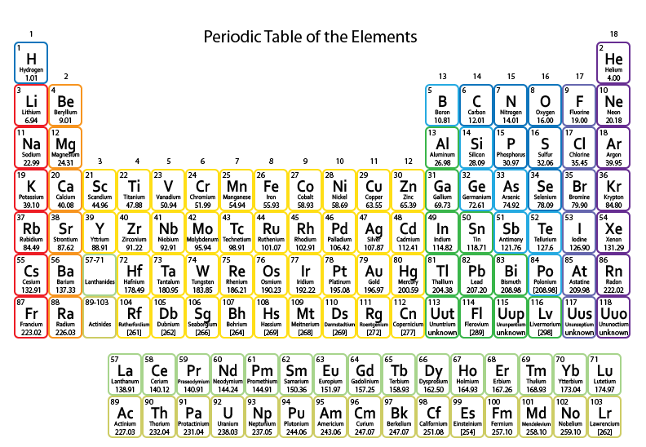
Our program
Pal 3 (R_{GC} = 96 kpc; AK et al. 2009) Pal 4 (R_{GC} = 111 kpc; AK et al. 2010)
Pal 5 (R_{GC} = 19 kpc; AK et al. 2017) Pal 13 (R_{GC} = 27 kpc; AK et al. in prep.)
Pal 15 (R_{GC} = 38 kpc; AK et al. 2019)

Slide 6
Palomar 15
Pal 15 (R_{GC} = 38 kpc; [Fe/H] = -1.94): indistinguishable
from remainder of outer halo GCs
Mean,1σ, and mean error
of all outer halo GCs > 20 kpc with abundances

Slide 7
Accreted GCs
The MW has experienced three major accretion events:
Sagittarius (Ibata et al. 1994)
Sequoia (Myeong et al. 2019) == The Kraken (Kruijssen et al. 2019)
Gaia Enceladus / Gaia Sausage (Helmi et al. 2018, Belokurov et al. 2018) == Canis Major overdensity / warp (Momany et al. 2006)
Kinematics and ages of 151 GCs (Massari et al. 2019):
40% in situ,
29% from Gaia-Enceladus,
~5% from Sgr and Sequoia
Rest: various streams (Helmi & White 1999), unassociated, …
Pal 13 (R_{GC} = 27 kpc; 13 Gyr) claimed to be
associated with Sequoia
→ Also chemical evidence?
Notes:
rest from streams or unassociated or dunno
For the first time, thanks to Gaia, objects could be associated with potential progenitors, and
Pal 13 has been suggested to be from Seq

Slide 8
Palomar 13 vs. halo field & GCs
Mean metallicity of [Fe/H] = –1.9, typical of old, outer halo GCs.
Abundance ratios of the 14 studied elements (α-, Fe-peak, n-cap.) indistinguishable from field stars and other GCs.

Slide 9
Palomar 13 vs. accretion events
Gaia-Enc. stellar component:
huge spreads in [Fe/H] and
[X/Fe] → not conclusive
The Gaia-Enc. GCs also show
a broad spread in [Fe/H],
overlapping with Pal 13.
Sequoia GCs:
smaller spread (–2 to –1.6)
[α/Fe] from ~0 to > 0.5
NGC 5466:
most m.-poor of Seq. GCs
closest abundance match with Pal 13 (Lamb et al. 2015)
Notes:
5466 – Seq GC
Intriguingly Lamb et al. 2015 state that they chose this object for abundance analysis ``to examine chemical trends that may correlate them with the Sgr dwarf galaxy remnant.'' However, at its low metallicity ([Fe/H]=-2) they did not detect any obvious differences from the Galactic halo abundance patterns.
This emphasizes the intractability in uniquely tracing the origin of a system like Pal~13 in a given merger event, based on chemistry alone.

Slide 10
Summary
Even if GC abundances are utterly like the surrounding field, this tells us about their formation history.
Keck/HIRES program → chemical tagging of outer halo objects to map the history of the outer MW, and to associate them with potential accretion events.
Thanks to Gaia, GCs can now potentially be associated with accretion progenitors. Chemically not that straightforward.
→ Pal 15: no evidence for accretion.
→ Pal 13: Sequoia? Not implausible.
Similar to another Sequioa GC (NGC 5466)
Majority of Sequoia-GCs are currently at large Galacto-centric distances in excess of 10 kpc
→ Systematic studies needed!
Notes:
, Gaia-Enc. GCs at 7—38 kpc, with 40% <10 kpc

Slide 11
GC–dSph–field connection
Also within dwarf spheroidals, their globular clusters are coupled to the surrounding field population.
Hendricks et al. (2016)
MW GCs
M31 GCs (Colucci et al. 2014; Sakari et al. 2015)
Fornax field stars
(Letarte et al. 2010; Lemasle et al. 2014; Hendricks, AK, et al. 2014)
Fornax GC stars
(Letarte et al. 2006; Larsen et al. 2012; Hendricks, AK, et al. 2016)
Notes:
So, GCs are excellent tracers of the Galactic components and they deserve to be looked at in great detail.
STARS in dwarf galaxies
lower alpha abundances owing to the way lower star formation
efficiencies.

